Slide 1
Mathematical Economics

Slide 2
Linear Demand & Supply Functions

Slide 3
Typical Demand Function
Demand for a good can be expressed using mathematical functions
A typical demand function looks like Q_{D} = a – bP where,
Q_{D} represents the quantity demanded
a represents the autonomous level of demand, or the quantity demanded if the price were zero (Q-intercept)
b represents the change in quantity demanded resulting from a change in price (the slope calculated as ∆Q_{d}/∆P)
P represents the price of a single item

Slide 4
Example; Demand for Cappuccinos
Suppose the demand for cappuccinos in Richmond Hill can be expressed as Q_{D} = 600 – 50P
It is possible to construct both a demand schedule and demand curve from this demand function
Linear demand schedule: Cappuccinos
Price of Cappuccinos (P) | Quantity demanded per day (Q_{D})
10 | 100
8 | 200
6 | 300
4 | 400
2 | 500
0 | 600

Slide 5
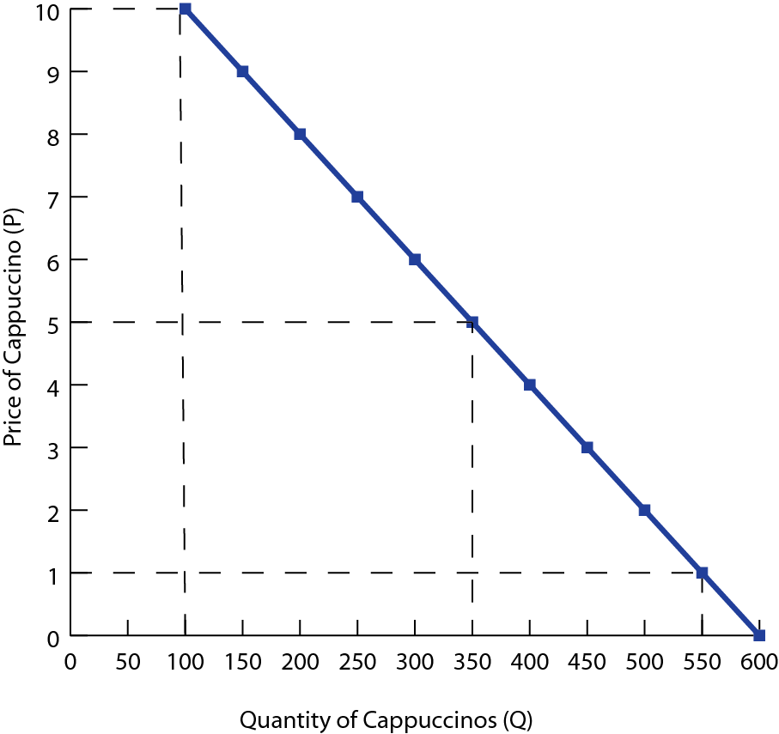
A movement along the demand curve will occur any time the price of cappuccinos increases or decreases
At lower prices, more are demanded; at higher prices fewer cappuccinos are demanded by consumers

Slide 6
Changes in ‘a’
If any of the determinants of demand change, then the ‘a’ value in the demand function will change
The demand curve will shift either left or right
Example; Suppose the demand function changes to Q_{D} = 500 – 50P
Linear demand schedule: Cappuccinos
Price of Cappuccinos (P) | Quantity demanded per day (Q_{D})
10 | 0
8 | 100
6 | 200
4 | 300
2 | 400
0 | 500

Slide 7
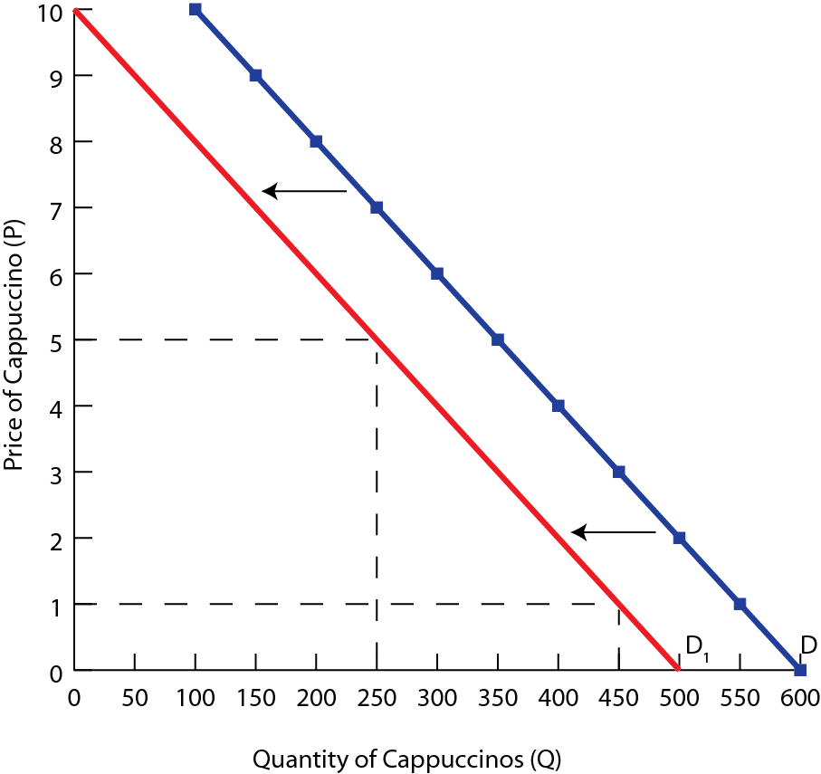
The slope of the new demand curve will be the same as the original curve
The demand curve shifts left, or down by 100 units at every price
The Q-intercept is now at 500 rather than 600

Slide 8
Changes in ‘b’
Changes to the price coefficient b will change the steepness of the demand curve
This changes the price elasticity of the demand curve
Example; Suppose the demand function changes to Q_{D} = 600 – 30P
Linear demand schedule: Cappuccinos
Price of Cappuccinos (P) | Quantity demanded per day (Q_{D})
10 | 300
8 | 360
6 | 420
4 | 480
2 | 570
0 | 600

Slide 9
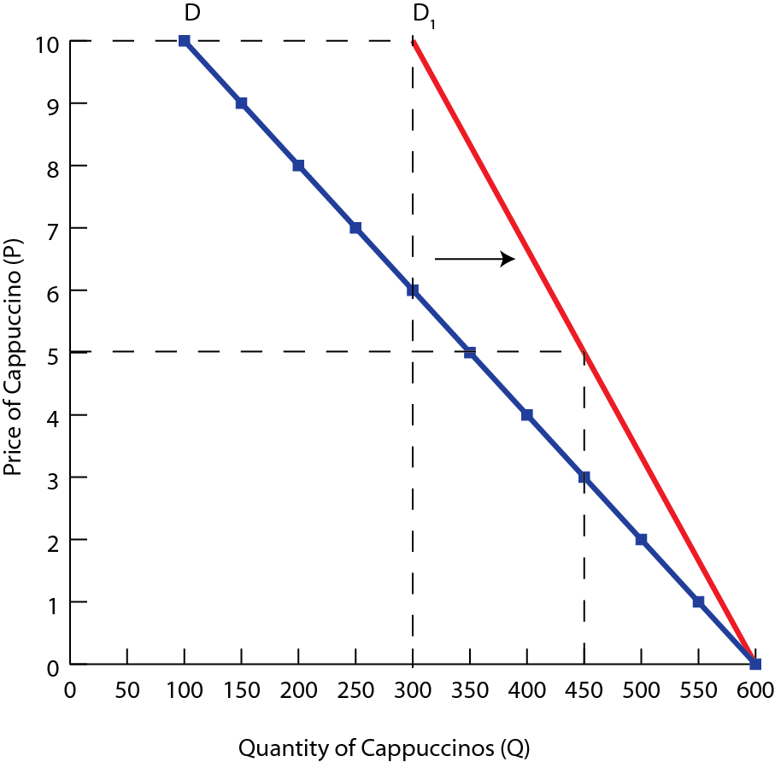
The demand curve has become steeper, indicating consumers are less sensitive to price changes than previously
The overall demand for cappuccinos has become more inelastic

Slide 10
Typical Supply Function
Supply for a good can also be expressed using mathematical functions
A typical supply function looks like Q_{S} = c + dP where,
Q_{S} represents the quantity supplied
c represents the autonomous level of supply, or the quantity produced if the price were zero (Q-intercept)
d represents the rate at which a change in price will cause the quantity supplied to increase (the slope calculated as ∆Q_{s}/∆P)
P represents the price of a single item

Slide 11
Example; Supply Cappuccinos
Suppose the supply of cappuccinos in Richmond Hill can be expressed as Q_{s} = -200 + 150P
It is possible to construct both a supply schedule and supply curve from this supply function
Linear supply schedule: Cappuccinos
Price of Cappuccinos (P) | Quantity supplied per day (Q_{D})
10 | 1300
8 | 1000
6 | 700
4 | 400
2 | 100
0 | -200

Slide 12
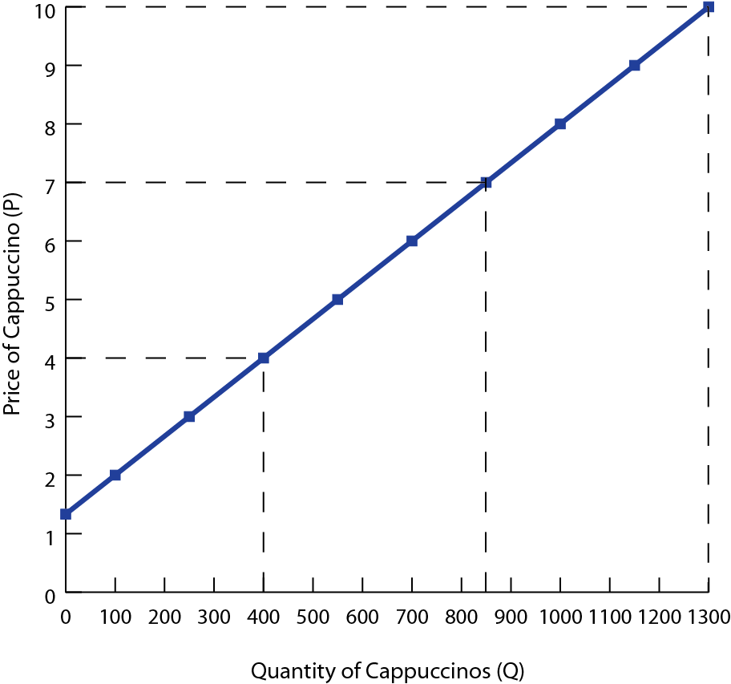
There is a direct relationship between the price and quantity supplied. As price falls, producers are willing to provide fewer drinks to the market

Slide 13
Changes in ‘c’
If any of the non-price determinants of supply change, then the ‘c’ value in the supply function will change
The supply curve will shift either left or right
Example; Suppose the supply function changes to Q_{S} = - 100 + 150P
Linear supply schedule: Cappuccinos
Price of Cappuccinos (P) | Quantity supplied per day (Q_{D})
10 | 1400
8 | 1100
6 | 800
4 | 500
2 | 200
0 | -100

Slide 14
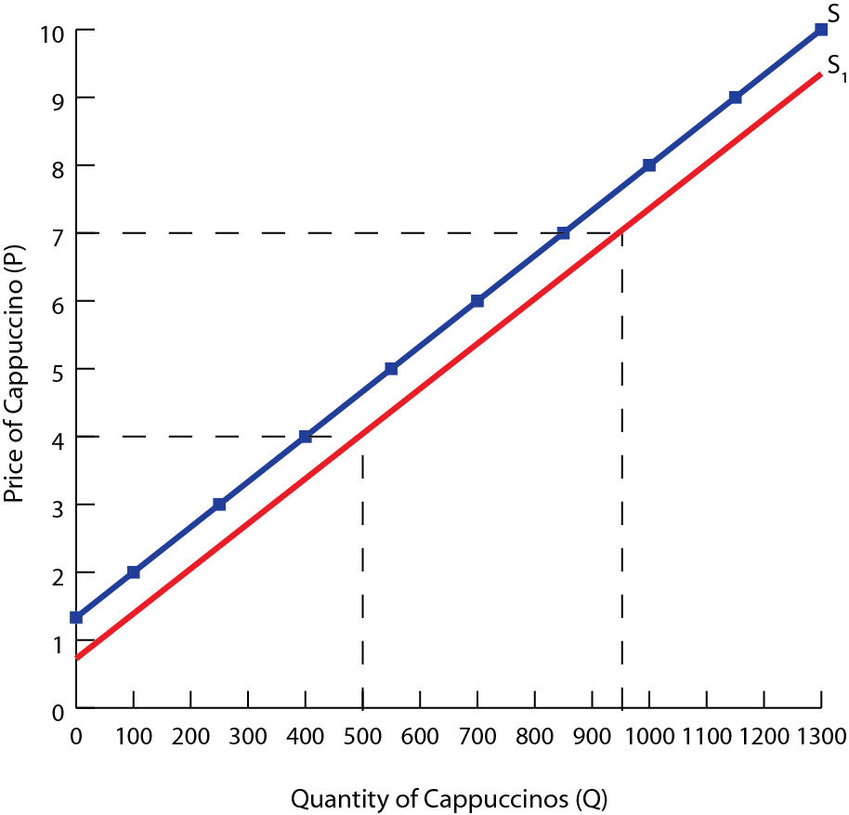
The quantity supplied at each price level is reduced, but the slope remains the same
The price intercept is now $0.75 rather than $1.33

Slide 15
Changes in ‘d’
Changes to the price coefficient d will change the steepness of the supply curve
This changes the price elasticity of the supply curve
Example; Suppose the supply function changes to Q = -200 + 200P
Linear supply schedule: Cappuccinos
Price of Cappuccinos (P) | Quantity supplied per day (Q_{D})
10 | 1800
8 | 1400
6 | 1000
4 | 600
2 | 200
0 | -200

Slide 16
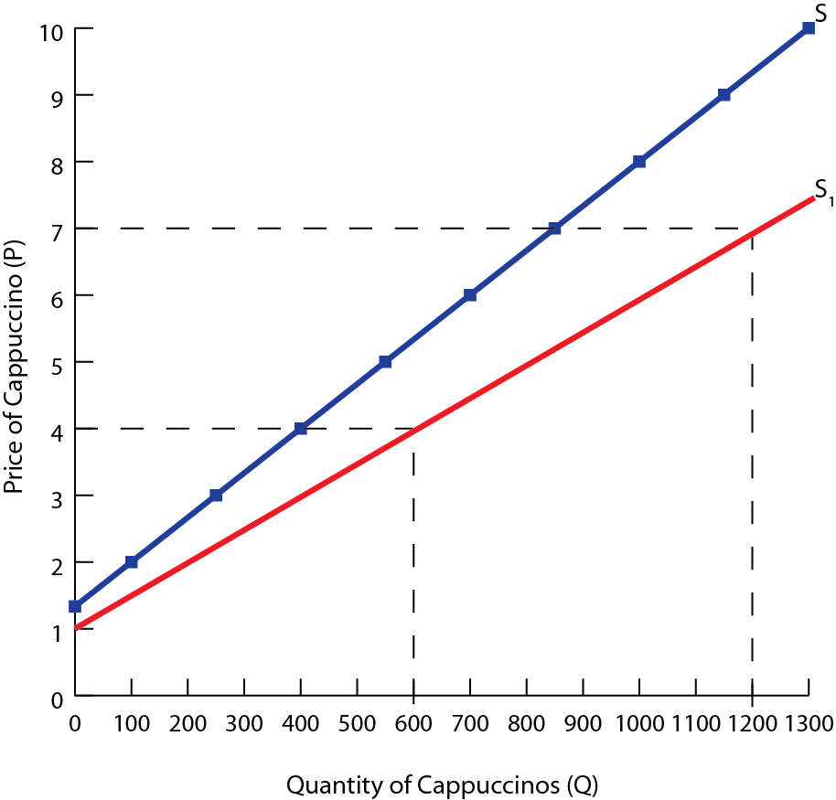
The supply curve is less steep, indicating consumers are more sensitive to price changes than previously
The overall supply for cappuccinos has become more elastic

Slide 17
Summary
 | Component | Change | Impact on Demand/Supply
Linear Demand (Q_{d} = a − bP) Linear Supply (Q_{s} = c + dP) | a or c | Increase | Rightward shift (Increase)
 | a or c | Decrease | Leftward shift (Decrease)
 | b or d | Increase | Less steep (Elastic)
 | b or d | Decrease | More steep (Inelastic)

Slide 18
Study Questions
1. Use the linear demand function, Q_{D} = 300 – 30P
A. Create a demand schedule with prices of $0, $3, $5, $7 and $9
B. Create a demand curve, plotting point from your demand schedule
C. Decrease the value of a, the autonomous element of demand, by 30 units. Create a new demand schedule, with the adjusted values for Q_{D}.
D. On your previous diagram, show the new demand curve
E. Now change the value of the price coefficient, in the original function to – 10. Calculate the prices and quantities demanded, and list them of a demand schedule
F. Create a new demand curve

Slide 19
Study Questions
1. Use the linear demand function, Q_{S} = -100 + 10P
A. Create a supply schedule with prices of $10, $20, $30, $40 and $50
B. Create a supply curve, plotting point from your demand schedule
C. Decrease the value of c, the autonomous element of supply, by 50 units. Create a new supply schedule, with the adjusted values for Q_{S}.
D. On your previous diagram, show the new supply curve

Slide 20
Market Equilibrium and Linear Equations

Slide 21
Market Equilibrium and Linear Equations
Linear equations can be used to solve the market equilibrium by setting the quantity supplied equal to the quantity demanded
The market is in equilibrium when Q_{d} = Q_{s}
Example; Suppose the market for cappuccino can be modeled by the following, Q_{d} = 600 – 50P and Q_{s} = – 200+ 150P
Linear supply and demand schedules: Cappuccinos
Price of Cappuccinos (P) | Quantity demanded (Q_{D}) | Quantity supplied (Q_{S})
10 | 100 | 1300
8 | 200 | 1000
6 | 300 | 700
4 | 400 | 400
2 | 500 | 100
0 | 600 | -200

Slide 22
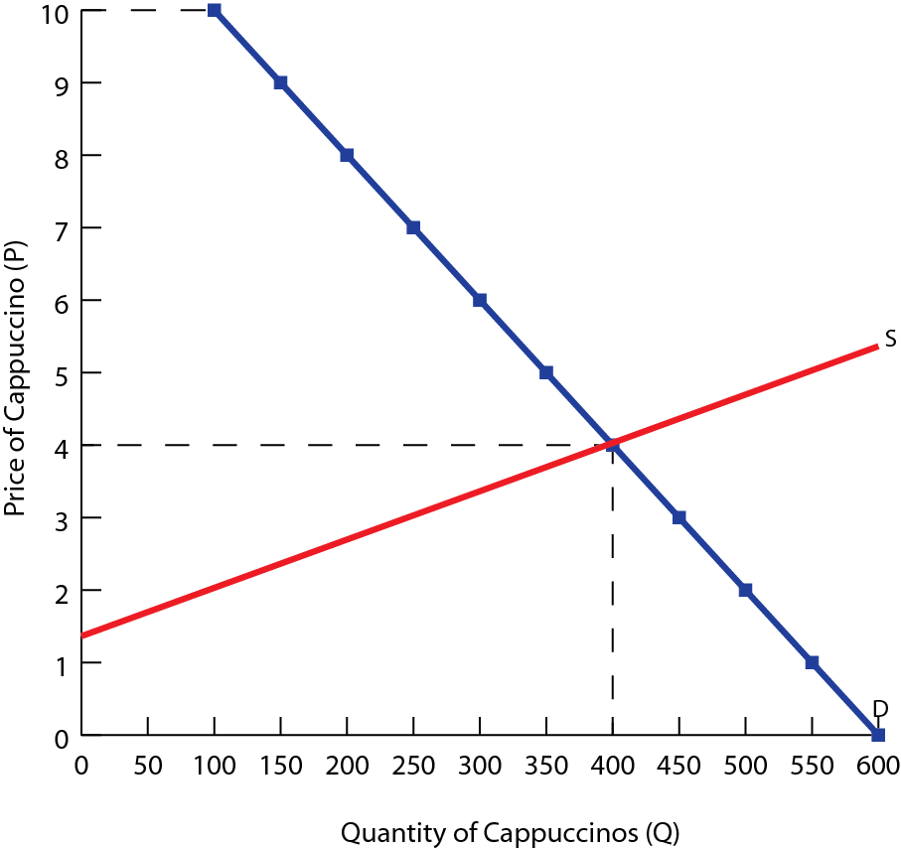
The equilibrium is the point at which supply equals demand,
Q_{d} = Q_{s}
600 – 50P = – 200+ 150P
200P =800
Therefore, P_{E}= $4 and Q_{E}= 400 units
Therefore the equilibrium price is $4 and the quantity is 400 units

Slide 23
Shifts in Supply and Equilibrium
Shifts in the supply can also be illustrated using linear functions
Example; Suppose the price of coffee beans increases, adding to the costs of the production of cappuccino and reducing the supply. The new supply function is Q_{s} = – 400+ 150P
Linear supply schedule: Cappuccinos
Price of Cappuccinos (P) | Quantity supplied per day (Q_{D})
10 | 1100
8 | 800
6 | 500
4 | 200
2 | -100
0 | -400

Slide 24
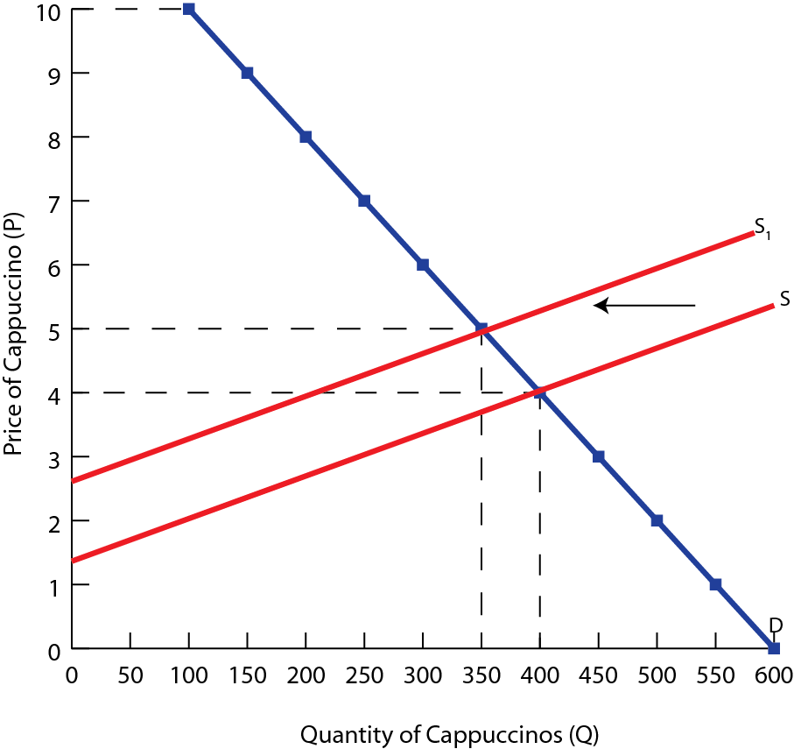
Solving the new equilibrium,
Q_{d} = Q_{s}
600 – 50P = – 400+ 150P
200P =1000
Therefore, P_{E}= $5 and Q_{E}= 350 units
The price rises until the market is cleared, with all excess demand eliminated

Slide 25
Shifts in Demand and Equilibrium
Changes in demand will also effect the equilibrium price and quantity
Example; Suppose a decrease in the demand for cappuccinos shifts the demand curve to the right. In addition, the demand curve becomes less elastic. The new demand function is Q_{d} = 400 – 25P
Solving the new equilibrium algebraically,
Q_{d} = Q_{s}
400 – 25P = – 200+ 150P
600P =175
Therefore, P_{E}= $3.43 and Q_{E}= 314 units

Slide 26
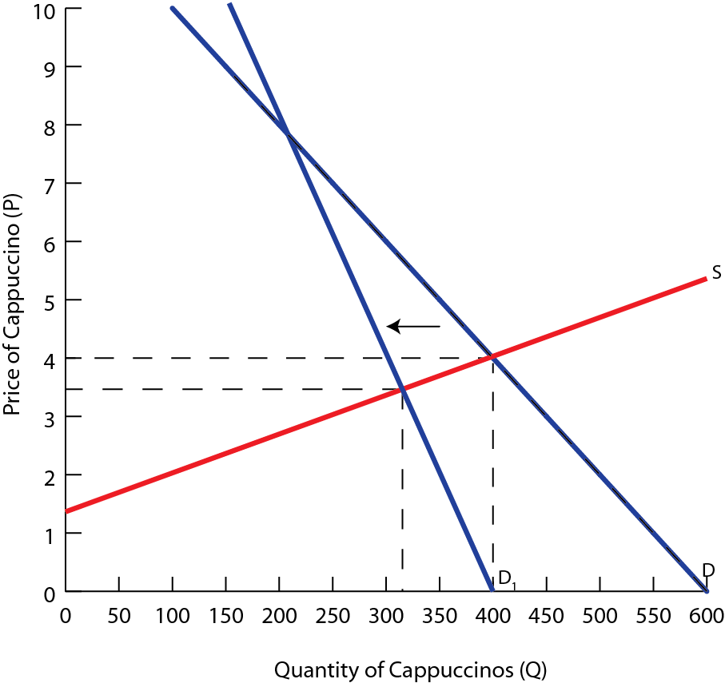
The decrease in demand causes the price of cappuccinos to fall from $4 to $3.43 and the equilibrium quantity to decrease from 400 to 314 drinks

Slide 27
Tax & Subsidies and Linear Functions

Slide 28
Overview
Given a supply function of the general form Q_{S} = c + dP
Whenever there is a downward shift of the function by s units, where s is the subsidy per unit we replace P by P + s. The new supply function therefore becomes Q_{S} = c + d(P + s).
Whenever there is a upward shift of the function by t units, where t is the tax per unit we replace P by P − t. The new supply function therefore becomes Q_{S} = c + d(P − t).
 | Original Function | Revised Function
Taxes (t) | Q_{s} = c + dP | Q_{s} = c + d(P − t)
Subsidy (s) | Q_{s} = c + dP | Q_{s} = c + d(P + s)

Slide 29
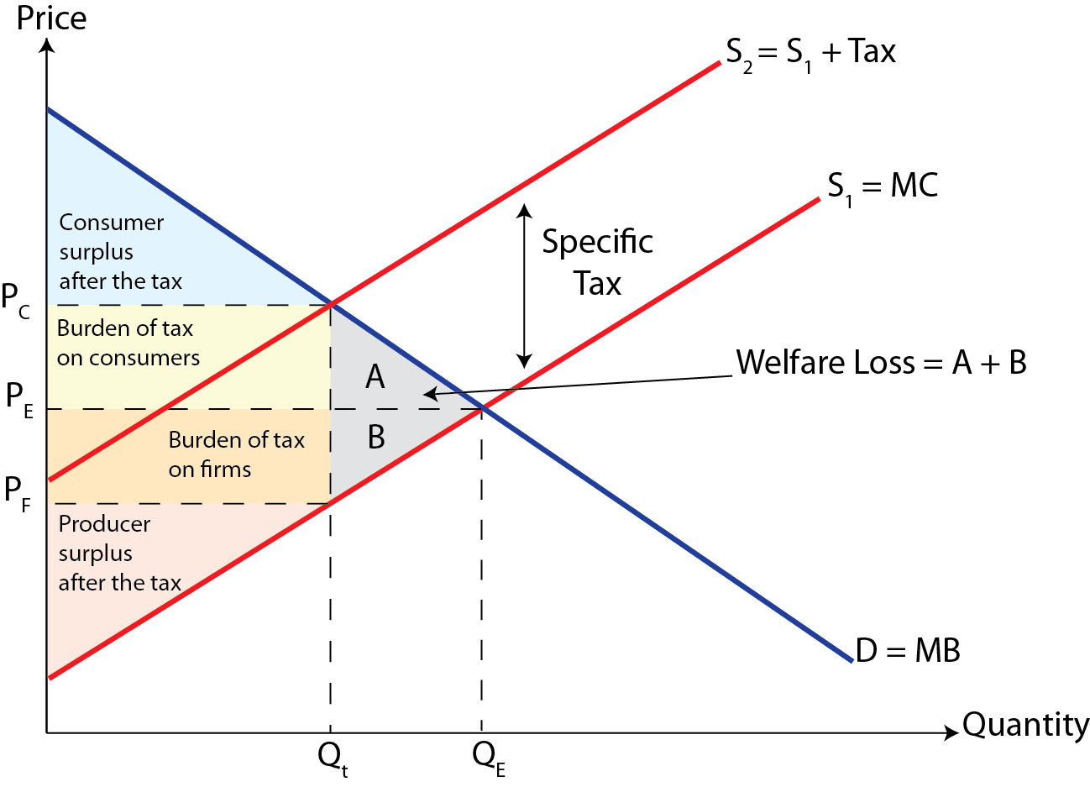
Recap- Indirect Taxes

Slide 30
Tax Incidence and Linear Functions
Linear functions can be used for the analysis of tax incidence
Example; Suppose the demand and supply of cigarettes can be modeled as follows, Q_{D} = 1600 – 200P and Q_{S} = 600 + 300P
Linear supply and demand schedules: Cigarettes
Price (P) | Quantity demanded (Q_{D}) | Quantity supplied (Q_{S})
5 | 600 | 2100
4 | 800 | 1800
3 | 1000 | 1500
2 | 1200 | 1200
1 | 1400 | 900
0 | 1600 | 600

Slide 31
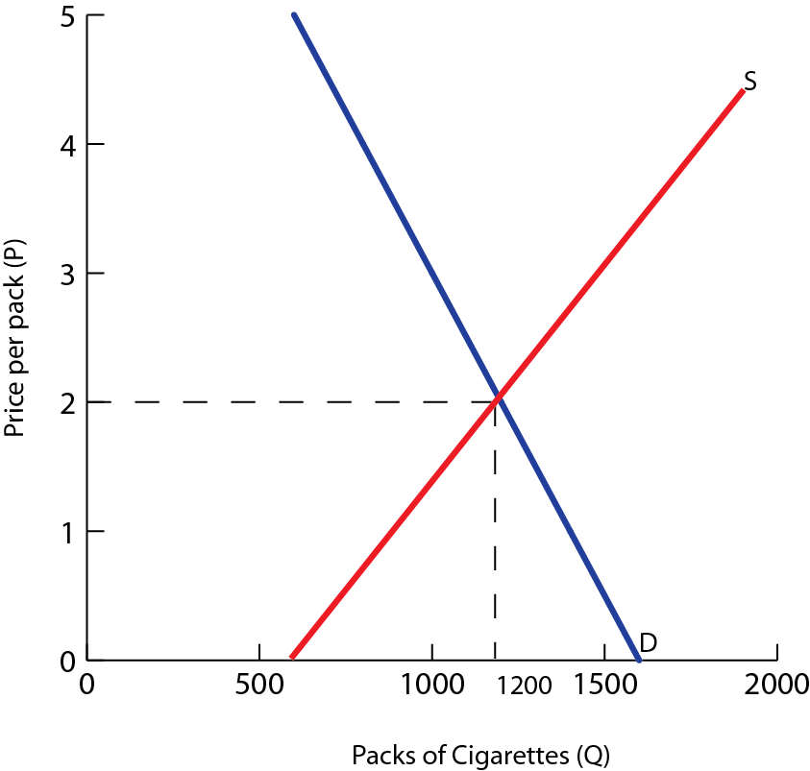
We can determine the equilibrium price and quantity, algebraically
Q_{d} = Q_{s}
1600 – 200P = 600+ 300P
500P =1000
Therefore, P_{E}= $2 and Q_{E}= 1200 units
Therefore the equilibrium price is $2 and the quantity is 1200 units

Slide 32
Example; Tax on Cigarettes
Example; Suppose the government places a $1 tax on each pack of cigarettes
The tax is a cost imposed on the producers of cigarettes, so whatever the price consumers pay, $1 must be given over to the government
Therefore, producers will receive $1 less than the new equilibrium price
The new supply function can be expressed as ,Q_{S} = 600 + 300(P – 1) or by simplifying we get Q_{S} = 300 + 300P
To determine the new equilibrium, we set the new supply equal to demand

Slide 33
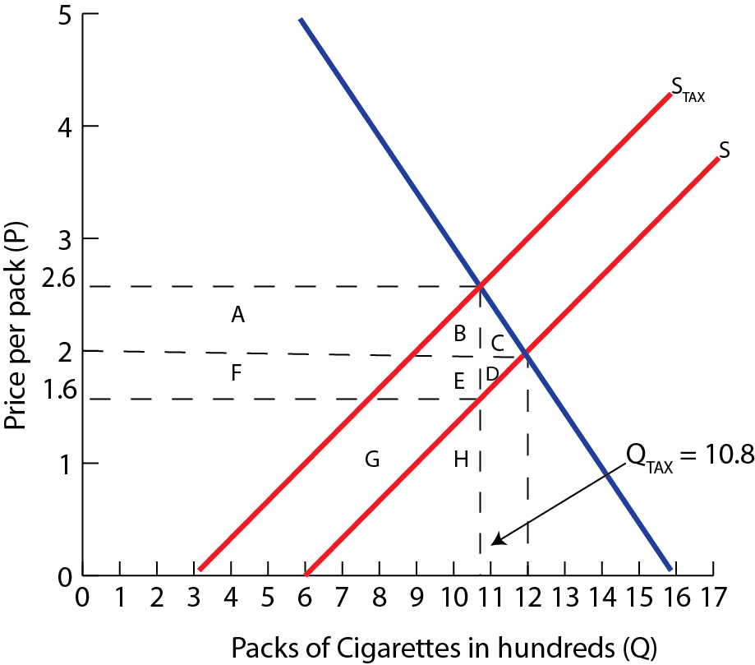
Q_{d} = Q_{s}
300 + 300P = 1600 - 200P
500P =1300
Therefore, P_{E}= $2.6 and Q_{E}= 1080 unit
Therefore the equilibrium price is $2.6 and the quantity is 1080 units
1080 = 600 + 300P
480 = 300P
P = $1.60
Calculate
1) Tax Revenue
2) Consumer Tax Burden
3) Producer Tax Burden
4) ∆ Consumer Surplus
5) ∆ Producer Surplus
6) Welfare Loss

Slide 34
Because the demand for cigarettes is relatively inelastic, the larger burden of the tax is passed on to consumers.
We can also analyze the impact of the tax on various other factors,
Tax revenue: is shown by the area A + B + E + F and is equal to $1 × 1080 = $1080
Consumer tax burden: is represented by the area A + B and is equal to ($2.60 - $2) × 1080 = $648
Producer tax burden: is represent by the area F + E and is equal to ($2 - $1.60) × 1080 = $432
Effect on consumer surplus: the loss of the consumer surplus is A + B + C which is equal to $648 + 0.5(72) = $684

Slide 35
Effect on producer surplus: the loss of producer surplus is represented by D + E + F and is equal to the producer burden plus the area of D which is $432 + 0.5(48) = $456
Welfare loss from the tax: overall, the amount of both consumer and producer surplus in the cigarette market falls because of the tax
The total loss in consumer and producer surplus is $1140
Net welfare loss = ∆G + ∆CS + ∆PS
= $1080 − $684 − $456
= $60
The tax on cigarettes creates $1080 of government revenue, but imposes a $60 welfare loss to society
Since consumers and producers of cigarettes lose more welfare than society gains in tax revenue

Slide 36
Subsidies and Linear Functions

Slide 37
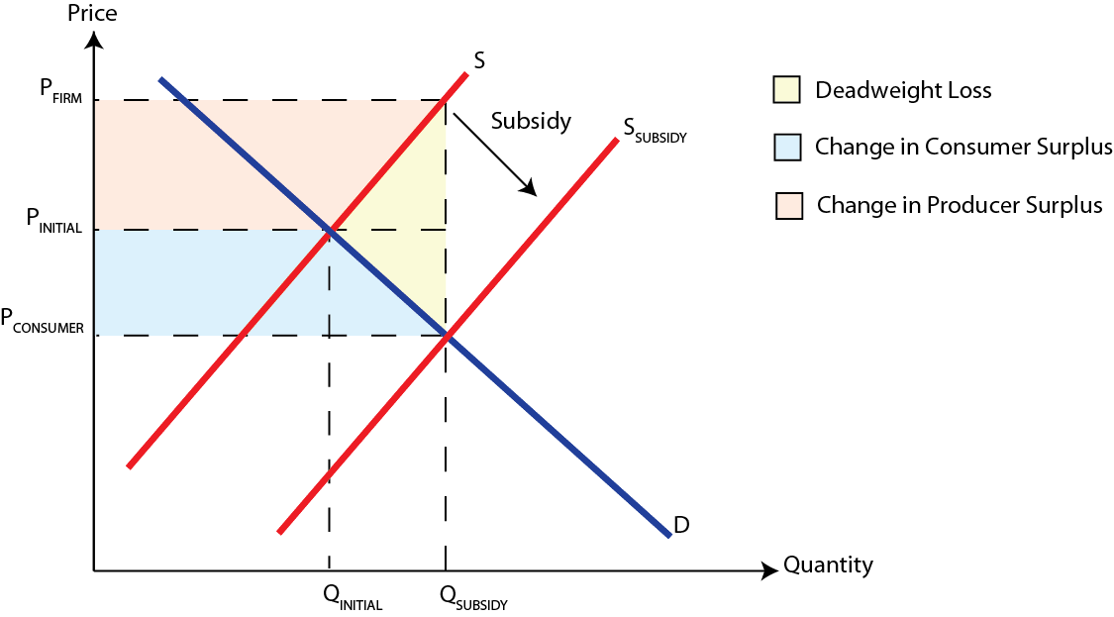
Recap- Subsidies

Slide 38
Subsidies and Linear Functions
Linear functions can be used for the analysis of subsidies
Example; Suppose the demand and supply of cotton can be modeled as follows, Q_{D} = 30 – 4P and Q_{S} = 6 + 2P
Linear supply and demand schedules: Cigarettes
Price (P) | Quantity demanded (Q_{D}) | Quantity supplied (Q_{S})
6 | 6 | 18
4 | 14 | 14
3 | 18 | 12
2 | 22 | 10
1 | 26 | 8
0 | 30 | 6

Slide 39
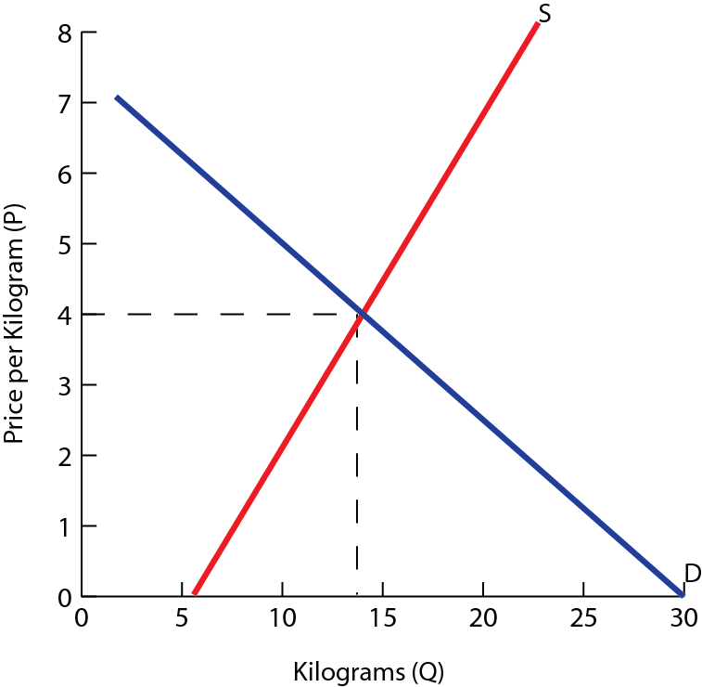
We can determine the equilibrium price and quantity, algebraically
Q_{d} = Q_{s}
30 – 4P = 6+ 2P
6P =24
Therefore, P_{E}= $4 and Q_{E}= 14 units
Therefore the equilibrium price is $4 and the quantity is 14 units

Slide 40
Example; Subsidy on Cotton
Example; Suppose the government places a $3 subsidy on each kilogram of cotton
The producers will now receive $3 more per kilogram produced than the price the consumers pay
The new supply function can be expressed as ,Q_{S} = 6 + 2(P + 3) or by simplifying we get Q_{S} = 12 + 2P
To determine the equilibrium after the price subsidy, we set the new supply function equal to demand

Slide 41
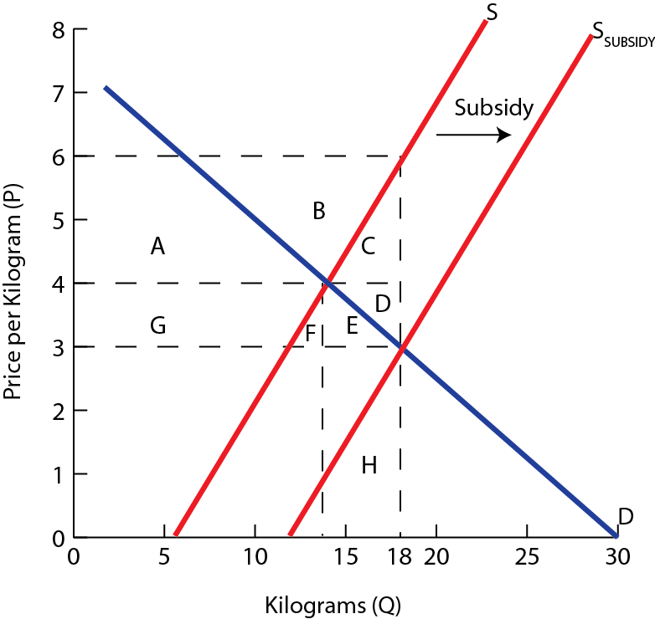
Q_{d} = Q_{s}
12 + 2P = 30 - 4P
6P =18
Therefore, P_{E}= $3 and Q_{E}= 18 units
Therefore the equilibrium price is $3 and the quantity is 18 units
Calculate
1) Government Spending
2) ∆ Consumer Surplus
3) ∆ Producer Surplus
4) Welfare Loss

Slide 42
Both consumer and producer welfare increases as a result of a subsidy,
Change in consumer surplus: the increase in the consumer surplus is E + F + G since consumers now enjoy a lower price and greater quantity. This is equal to $16 million
Change in producer surplus: the increase in producer surplus is A + B which is equal to $32 million
Increase in total consumer and producer welfare: the subsidy increases producer and consumer welfare by $48 million
We also need to take into the account the cost to taxpayers and society of subsidizing cotton grower
Total cost of the subsidy: is A + B + C + D + E + F + G and is equal to $3 × 18 = $54 million

Slide 43
Net effect on welfare: the cost of the subsidy was $54 million, but the benefit was only $48 million, so the net loss of welfare for society was $6 million
Deadweight (welfare) loss: is represented by the area of triangle C + D which is equal to $6 million
The subsidy creates a deadweight loss for society as a whole
The taxpayer money used to subsidize cotton growers exceeds the increase in cotton growers and consumers welfare by $6 million

Slide 44
Price Ceilings & Price Floors

Slide 45
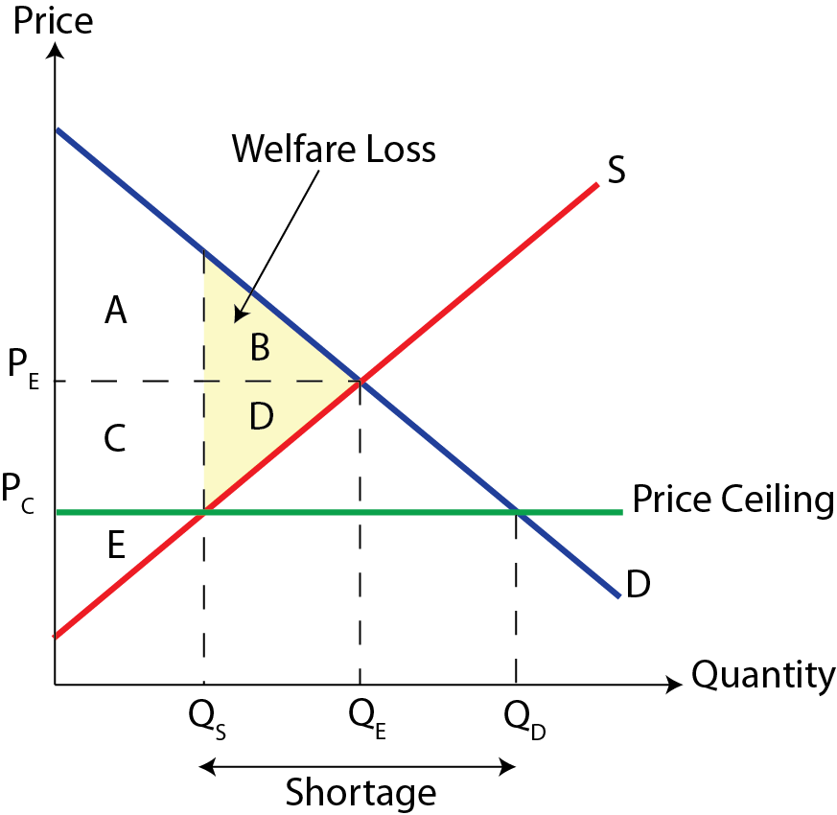
Recap- Price Ceiling
Price Ceiling- is a government imposed legal maximum price set below the market equilibrium.

Slide 46
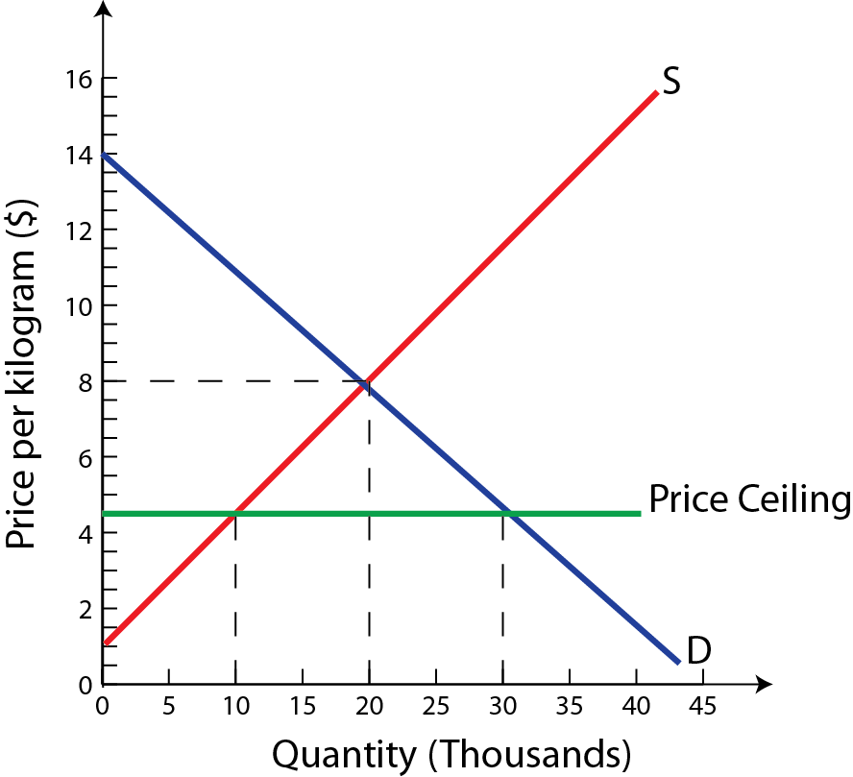
Price Ceiling
Example; Suppose the government imposes a price ceiling on rice of $4.50 per kilogram. This may be done to make basic food staples more affordable to low-income households.
Calculate
1) Shortage (Excess demand)
2) ∆ Consumer Spending
3) ∆ Producer Revenue

Slide 47
The original market equilibrium price was $8.00, at which 20,000 kilograms of rice are sold.
The price ceiling reduces the price to $4.50, which increases the quantity demanded to 30,000 and reduces the quantity supplied to 10,000 kilograms. Thus the price-ceiling results in a shortage.
Shortage: Q_{D} − Q_{S} = 30,000 − 10,000 = 20,000 kilograms
We can also analyze the impact of the price ceiling on the change in consumer expenditures or firm revenues.
∆Expenditures = Expenditures_{New} − Expenditures_{Old}
= ($4.50 × 10,000) − ($8.00 × 20,000)
= $45,000 − $160,000
= −$115,000

Slide 48
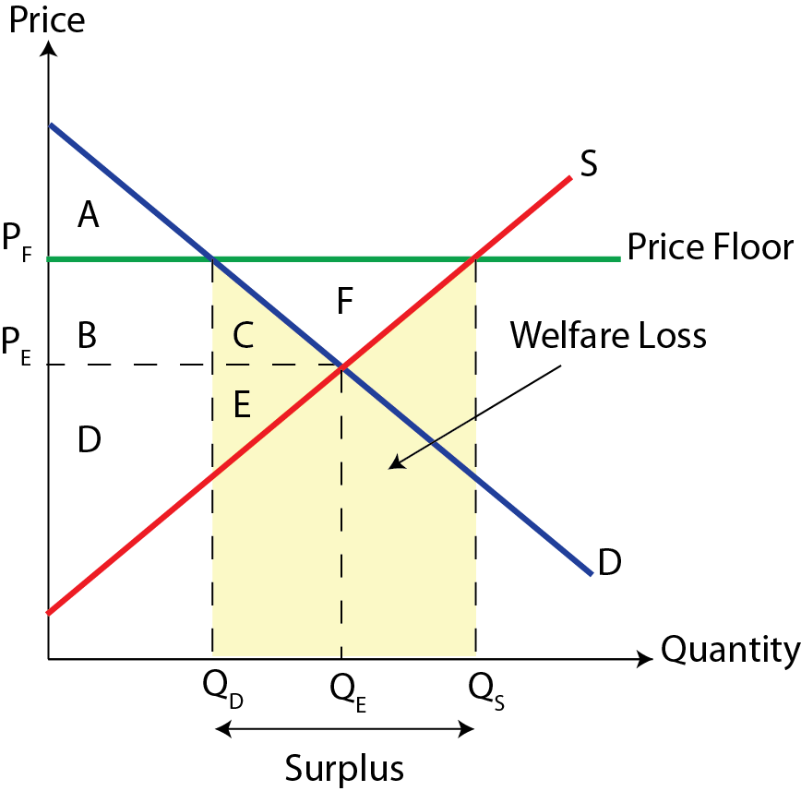
Recap- Price Floor
Price Floor- is a government imposed legal minimum price set above the market equilibrium.

Slide 49
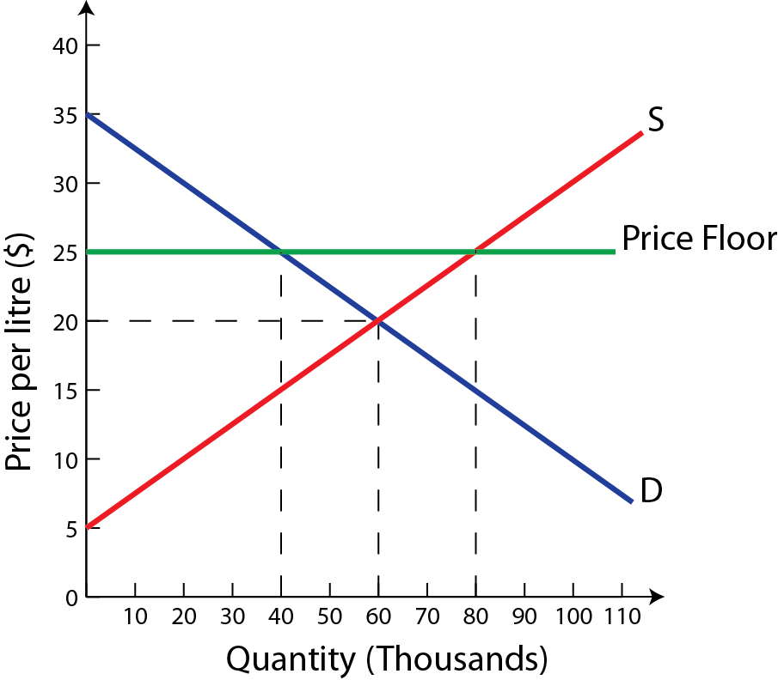
Price Floor
Example; Suppose the government imposes a price floor for wine of $25 per liter. This may be done to protect the income and employment of the country’s wine producers.
Calculate
1) Surplus (Excess supply)
2) ∆ Consumer Spending
3) ∆ Producer Revenue
4) Government Spending

Slide 50
The original market equilibrium price was $20, at which 60,000 liters of wine are sold.
The price ceiling raises the price to $25, which increases the quantity supplied to 80,000 and reduces the quantity demanded to 40,000 liters. Thus the price-floor results in a surplus.
Surplus: Q_{S} − Q_{D} = 80,000 − 40,000 = 40,000 liters
We can also analyze the impact of the price floor on various stakeholders,
∆Expenditures = Expenditures_{New} − Expenditures_{Old}
= ($25 × 40,000) − ($20 × 60,000)
= $1,000,000 − $1,200,000
= −$200,000
There is a reduction in consumer spending of $200,000

Slide 51
There is also an increase in the producers revenue of $800,000 as a result of the price floor.
∆Firm Revenue = Revenue_{New} − Revenue_{Old}
= ($25 × 80,000) − ($20 × 60,000)
= $2,000,000 − $1,200,000
= $800,000
The government must purchase the excess supply of wine to prevent the market from reverting back to the original equilibrium
Government Expenditure = Price × Quantity_{Surplus}
= ($25 × 40, 000)
= $1,000,000

Slide 52
Elasticities

Slide 53
Recap- Price Elasticity of Demand
Price Elasticity of Demand (PED): is a measure of the responsiveness of the quantity of a good demanded to changes in its price.
PED = %∆Q_{D} ÷ %∆P
Value of PED | Classification | Interpretation
Frequently Encountered Cases
0 < PED < 1 | Inelastic demand | Price insensitive
1 < PED < ∞ | Elastic demand | Price sensitive
Special Cases
PED = 1 | Unitary elastic demand | %∆Q_{D} = %∆P
PED = 0 | Perfectly inelastic demand | Fixed quantity
PED = ∞ | Perfectly elastic demand | Fixed price

Slide 54
There are several factors that determine whether the demand for a good is elastic or inelastic.
1) Number and closeness of substitutes
2) Necessities versus luxuries
3) Length of time
4) Proportion of income spent on a good
Along any downward-sloping, straight-line demand curve, the PED varies as we move along the curve.
Demand is price elastic at high-prices and low-quantities
Demand is price inelastic at low prices and large-quantities
At the midpoint of the demand curve, there is unit elastic demand

Slide 55

PED- Calculations
Example; Tesla Motors Model S retails for $85,000 in Canada in August. Approximately, 100 Model S vehicles were sold in August.
In September, the government implemented a rebate program of $5,000 for electric vehicles. Estimates indicate 110 vehicles will be sold in September.
PED = %∆Q_{D} ÷ %∆P
= [(Q_{NEW} − Q_{OLD})/Q_{OLD}] ÷ [(P_{NEW} − P_{OLD})/P_{OLD}]
= [(110 − 100)/100] ÷ [($80,000 − $85,000)/$85,000]
= 10% ÷ 5.8824%
= 1.70
This indicates that the demand for the Model S is price elastic, since the PED > 1 and a decrease in price will increase Tesla’s revenues.

Slide 56
Cross-Price Elasticity of Demand
Cross-Price Elasticity of Demand (XED): is a measure of the responsiveness of demand for one good to a change in the price of another good.
It involves demand curve shifts and provides information on whether demand increases or decreases, and on the size of the demand curve shifts
XED = %∆Q_{X} ÷ %∆P_{Y}
Value of XED | Classification | Example
XED > 0 | Substitutes | Coca-Cola & Pepsi
XED < 0 | Complements | Ice-Cream & Cones

Slide 57

XED- Calculations
Example; Suppose a convenience store decides to increase the price of a 500 mL bottle of Coca-Cola from $1.50 to $1.80.
The store maintains their prices for Pepsi and the quantity demanded for the product increases from 1,000 to 1,140 bottles in a particular month.
XED = %∆Q_{X} ÷ %∆P_{Y}
= [(Q_{NEW} − Q_{OLD})/Q_{OLD}] ÷ [(P_{NEW} − P_{OLD})/P_{OLD}]
= [(1,140 − 1,000)/1,000] ÷ [($1.80 − $1.50)/$1.50]
= 14% ÷ 20%
= 0.70
This indicates that Coca-Cola and Pepsi have a high degree of substitutability since XED > 0 and relatively close to 1.

Slide 58
Income Elasticity of Demand
Income Elasticity of Demand (YED): is a measure of the responsiveness of demand to changes in income.
It involves demand curve shifts and provides information on the direction of change of demand given a change in income and on the size of the change.
YED = %∆Q_{D} ÷ %∆Y
Value of YED | Classification | Interpretation
YED < 0 | Inferior Good | Quantity falls with income
YED > 0 | Normal Good | Quantity increases with income
0 < YED < 1 | Necessities | Income inelastic demand
YED > 1 | Luxuries | Income elastic demand

Slide 59

YED- Calculations
Example; Your income increases from £1,000 a month to £1,200 a month. As a result, the frequency that you dine-out at restaurants increases from 4 to 6 times per month.
YED = %∆Q_{D} ÷ %∆Y
= [(Q_{NEW} − Q_{OLD})/Q_{OLD}] ÷ [(Y_{NEW} − Y_{OLD})/Y_{OLD}]
= [(6 − 4)/4] ÷ [(£1,200 − £1,000)/£1,000]
= 50% ÷ 20%
= 2.50
This indicates that dining-out at restaurants has income elastic demand and is a normal good since XED > 1

Slide 60
Recap- Price Elasticity of Supply
Price Elasticity of Supply (PES): is a measure of the responsiveness of the quantity of a good supplied to changes in its price.
PES = %∆Q_{S} ÷ %∆P
Value of PES | Classification | Interpretation
Frequently Encountered Cases
0 < PES< 1 | Inelastic supply | Price insensitive
1 < PES < ∞ | Elastic supply | Price sensitive
Special Cases
PES = 1 | Unitary elastic supply | %∆Q_{S} = %∆P
PES = 0 | Perfectly inelastic supply | Fixed quantity
PES = ∞ | Perfectly elastic supply | Fixed price

Slide 61
There are several factors that determine whether the supply for a good is elastic or inelastic.
1) Length of time
The amount of time firms have to adjust their inputs and the quantity supplied in response to changes in price
2) Mobility of the factors of production
The ease and speed with which firms can shift resources and production between different products
3) Spare capacity of firms
The greater the spare capacity the more elastic the supply
4) Ability to store stocks
Firms that have an ability to store stocks are likely to have a more elastic supply than firms that cannot store stocks

Slide 62

PES- Calculations
Example; Suppose that the price of oil increases from $100 to $110 as a result of instability in the Middle East.
In response, the quantity of oil supplied by Canadian producers increases from 1.25 to 1.30 million barrels of oil per day.
PED = %∆Q_{S} ÷ %∆P
= [(Q_{NEW} − Q_{OLD})/Q_{OLD}] ÷ [(P_{NEW} − P_{OLD})/P_{OLD}]
= [(1.30 − 1.25)/1.25] ÷ [($110 − $100)/$100]
= 4% ÷ 10%
= 0.4
This indicates that the supply of oil from Canadian sources is price inelastic, since the PES < 1.

Slide 63
Summary of Key Characteristics
Elasticity | Values |  | Description
Price elasticity of demand PED = %∆Q_{D} ÷ %∆P Price elasticity of supply PES = %∆Q_{S} ÷ %∆P | PED = 0 | PES = 0 | Perfectly inelastic
 | PED < 1 | PES < 1 | Price inelastic
 | PED = 1 | PES = 1 | Unit elastic
 | PED > 1 | PES > 1 | Price elastic
 | PED = ∞ | PES = ∞ | Perfectly elastic
Cross-price elasticity of demand XED = %∆Q_{X} ÷ %∆P_{Y} | XED < 0 |  | Substitutes
 | XED = 0 |  | Unrelated
 | XED > 0 |  | Complements
Income elasticity of demand YED = %∆Q_{D} ÷ %∆Y | YED < 0 |  | Inferior good
 | YED > 0 |  | Normal good
 | 0 < YED < 1 |  | Income inelastic (Necessity)
 | YED > 1 |  | Income elastic (Luxury)

Slide 64
Study Questions
1. If the XED between Coca-Cola and Pepsi is 0.7, how will the demand for Coca-Cola change if the price of Pepsi increases by 5%?
2. Your income increases from £1000 a month to £1200 a month. As a result, you increase your purchases of pizza from 8 to 12 per month, and decrease your purchases of chees sandwiches from 15 to 10 per month.
A. Calculate your income elasticity of demand for pizzas and for cheese sandwiches.
B. What kind of goods are pizzas and cheese sandwiches for you?
C. Show using diagrams the effect of your increase in income on your demand for pizzas and cheese sandwiches.

Slide 65
Production & Costs in the Short-run

Slide 66
Total, Marginal & Average Product
Total Product (TP): is the total quantity of output produced by a firm
Marginal Product (MP): is the extra or additional output resulting from one additional unit of the variable input
It tells us by how much output increases as labour increases by one worker.
MP = ∆TP ÷ ∆Labour
Average Product (AP): is the total quantity of output per unit of variable input, or labour
This tells us how much output each unit of labour produces on average
AP = TP ÷ Labour

Slide 67
Example; TP, MP and AP
Labour (L) | Total Product (TP) | Marginal Product (MP) MP = ∆TP ÷ ∆Labour | Average Product (AP) AP = TP ÷ Labour
0 | 0 | − | −
1 | 2 | 2 | 2
2 | 5 | 3 | 2.5
3 | 9 | 4 | 3
4 | 14 | 5 | 3.5
5 | 18 | 4 | 3.6
6 | 21 | 3 | 3.5
7 | 23 | 2 | 3.3
8 | 24 | 1 | 3
9 | 24 | 0 | 2.7
10 | 23 | − 1 | 2.3
11 | 21 | − 2 | 1.9

Slide 68
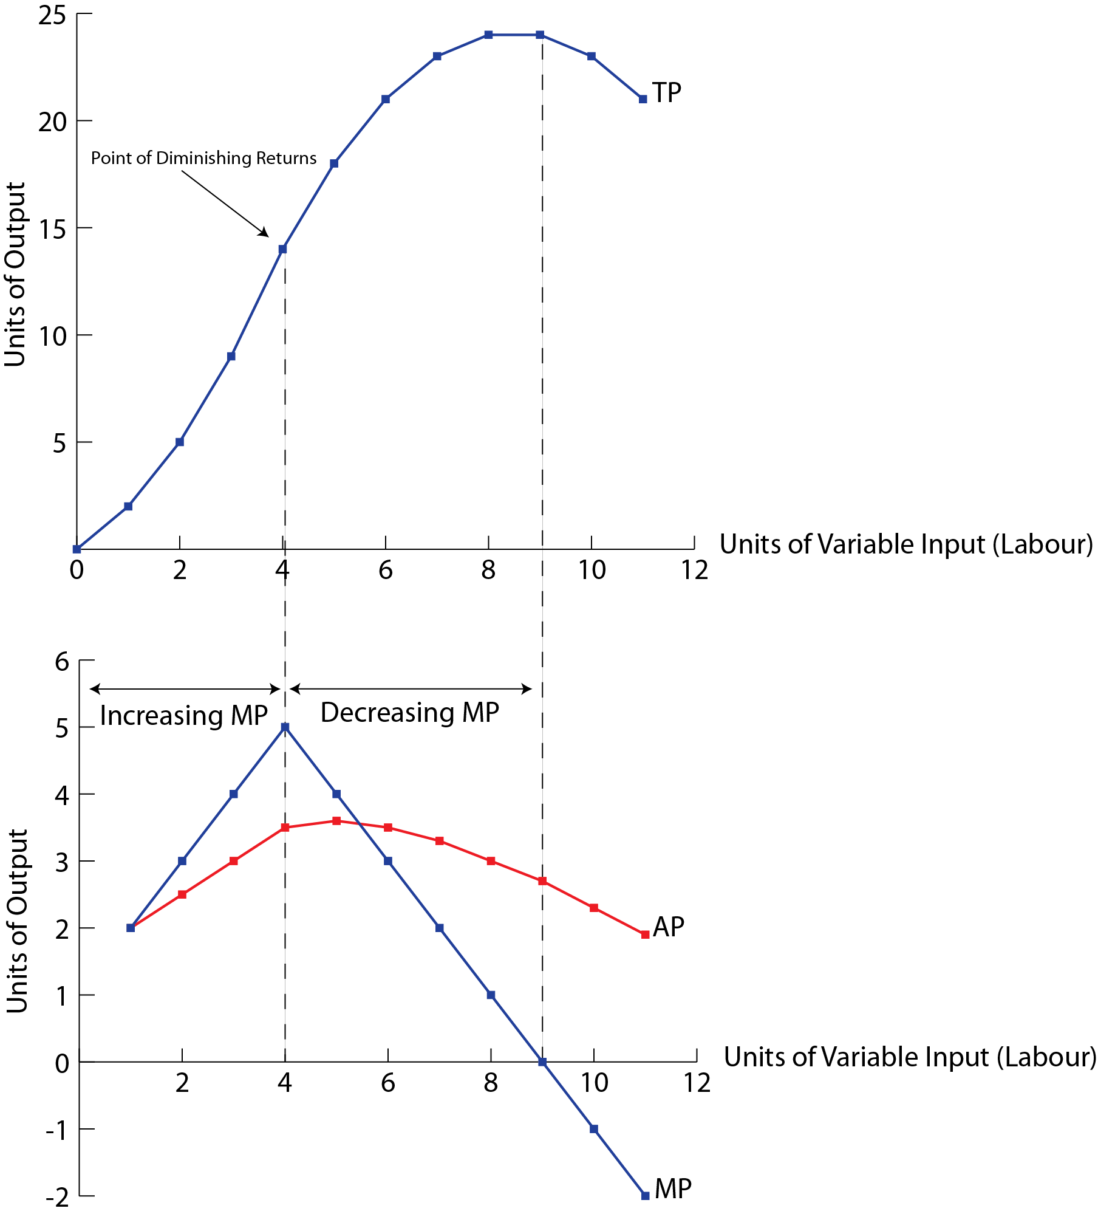
Law of Diminishing Returns: as more and more units of a variable input (such as labour) are added to one or more fixed inputs (such as land), the marginal product of the variable input at first increases, but there comes a point when it begins to decrease

Slide 69
Economic Costs
Economic Costs: are the sum of explicit and implicit costs, or total opportunity costs incurred by a firm for its use of resources, whether purchases or self-owned.
Economic Costs = Explicit Costs + Implicit Costs
When economists refer to ‘costs’ they mean ‘economic costs’
Explicit Costs: payments made by a firm to outsiders to acquire resources for use in production
Implicit Costs: the sacrificed income arising from the use of self-owned resources by a firm

Slide 70
Short-Run Costs
Fixed Costs (FC): arise from the use of fixed inputs. Fixed costs are costs that do not change as output changes.
Example; Rental payments, property taxes, insurance premiums
Variable Costs (VC): arise from the use of variable inputs. These costs change as output increases or decreases.
Example; Wage cost of labour
Total Costs: in the short-run, a firm’s total costs are the sum of fixed and variable costs.
In the long-run there are no fixed costs, therefore a firm’s total costs are equal to its variable costs
TC = TFC + TVC

Slide 71
Average and Marginal Costs
Average Costs: are costs per unit of output, or total cost divided by the number of units of output.
AFC = TFC ÷ Q (Average fixed costs)
AVC = TVC ÷ Q (Average variable costs)
ATC = TC ÷ Q
= AFC + AVC (Average total costs)
Marginal Cost (MC): is the extra or additional costs of producing one more unit of output.
MC = ∆TC ÷ ∆Q
= ∆TVC ÷ ∆Q

Slide 72
Example; Cost & Product Curves
Total Product (TP) | Labour (L) | TFC | TVC | TC | AFC | AVC | ATC | MC
0 | 0 | 200 | 0 | 200 | − | − | − | −
2 | 1 | 200 | 100 | 300 | 100 | 50 | 150 | 50
5 | 2 | 200 | 200 | 400 | 40 | 40 | 80 | 33.3
9 | 3 | 200 | 300 | 500 | 22.2 | 33.3 | 55.5 | 25
14 | 4 | 200 | 400 | 600 | 14.3 | 28.6 | 42.9 | 20
18 | 5 | 200 | 500 | 700 | 11.1 | 27.8 | 38.9 | 25
21 | 6 | 200 | 600 | 800 | 9.5 | 28.6 | 38.1 | 33.3
23 | 7 | 200 | 700 | 900 | 8.7 | 30.4 | 39.1 | 50
24 | 8 | 200 | 800 | 1000 | 8.3 | 33.3 | 41.6 | 100

Slide 73
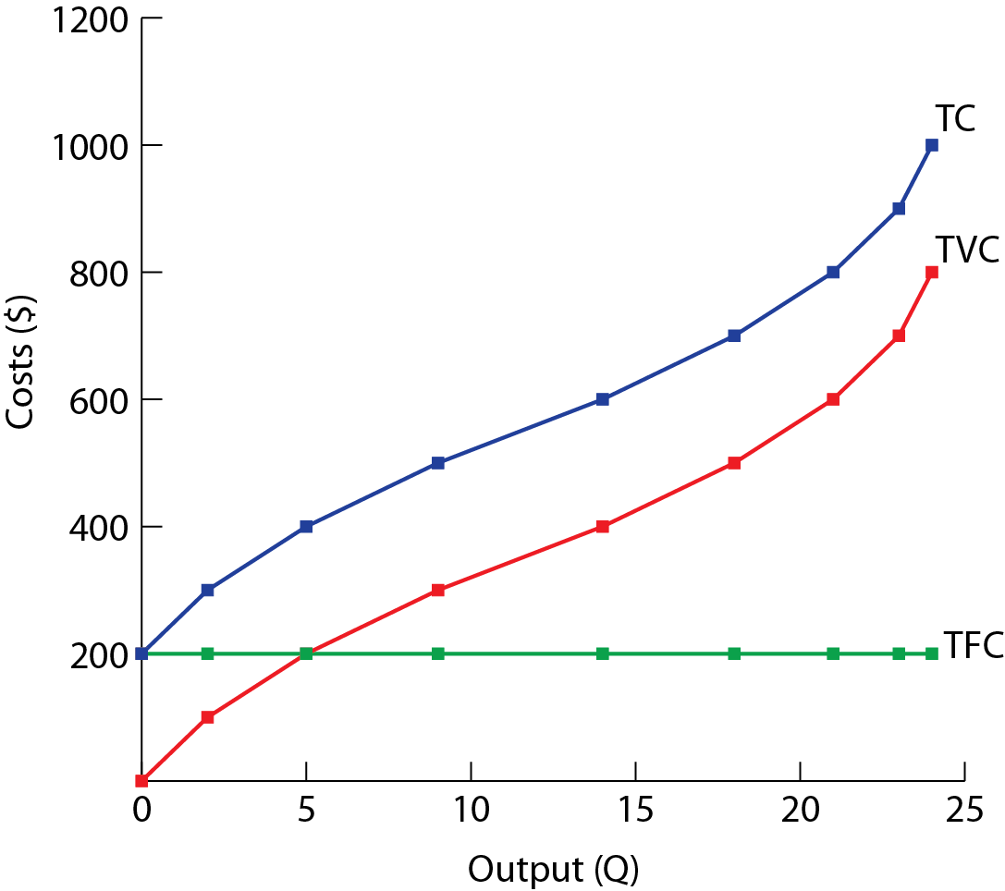
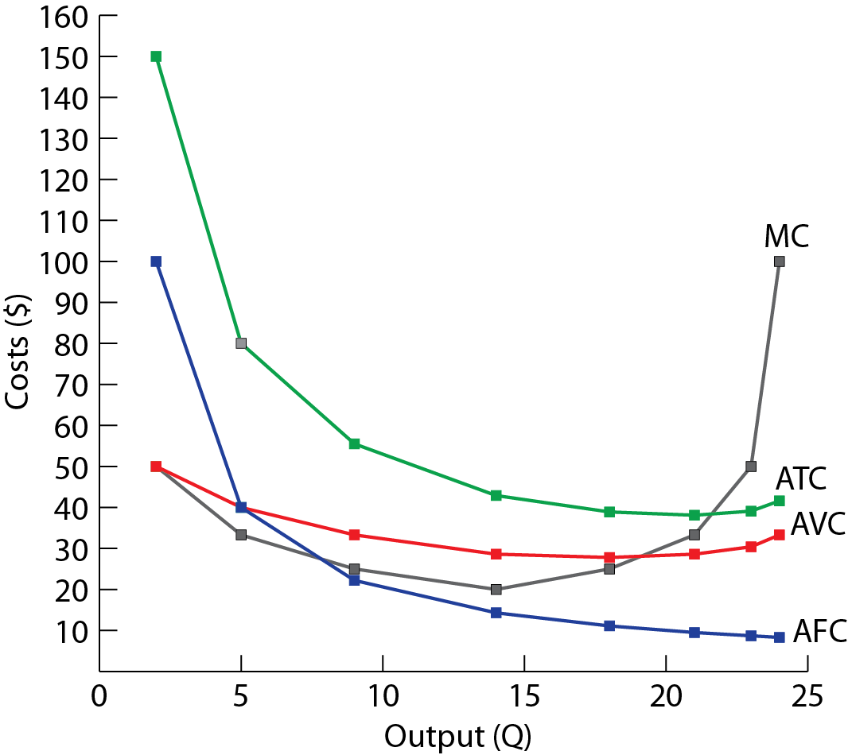

Slide 74
Summary
Concept | Definition | Equation
Product Concepts
Total product (TP) | The total amount of output produced
Marginal product (MP) | The additional output produced by one additional unit of variable input. | MP = ∆TP ÷ ∆L
Average product (AP) | Output per unit of variable input | AP = TP ÷ L
Cost Concepts
Total cost (TC) | The sum of fixed and variable costs | TC = TFC + TVC
Average fixed cost (AFC) | Fixed cost per unit of output | AFC = TFC ÷ Q
Average variable cost (AVC) | Variable cost per unit of output | AVC = TVC ÷ Q
Average total cost (ATC) | Total cost per unit of output | ATC = AFC + AVC
Marginal cost (MC) | The change in cost arising from one additional unit of output | MC = ∆TC ÷ ∆Q = ∆TVC ÷ ∆Q

Slide 75
Revenue & Economic Profit

Slide 76
Revenues
Total Revenue (TR): is obtained by multiplying the price at which the good is sold (P) by the number of units of the good sold (Q)
TR = P × Q
Marginal Revenue (MR): is the additional revenue arising from the sale of an additional unit of output
MR = ∆TR ÷ ∆Q
Average Revenue (AR): is the revenue per unit of output sold. It is always equal to the price.
AR = TR ÷ Q
= P

Slide 77
Revenues for Perfect Competition
Perfectly competitive firms compete in a market with a large number of firms each producing an identical product, and each firm’s output making up a tiny fraction of the total market supply
It is impossible for a single firm to affect the market price, and price at which the firm sells remains unchanged regardless of output
Output (Q) | Price (P) | Total Revenue TR = P × Q | Marginal Revenue MR = ∆TR ÷ ∆Q | Average Revenue AR = TR ÷ Q
1 | 10 | 10 | 10 | 10
2 | 10 | 20 | 10 | 10
3 | 10 | 30 | 10 | 10
4 | 10 | 40 | 10 | 10
5 | 10 | 50 | 10 | 10
6 | 10 | 60 | 10 | 10
7 | 10 | 70 | 10 | 10

Slide 78
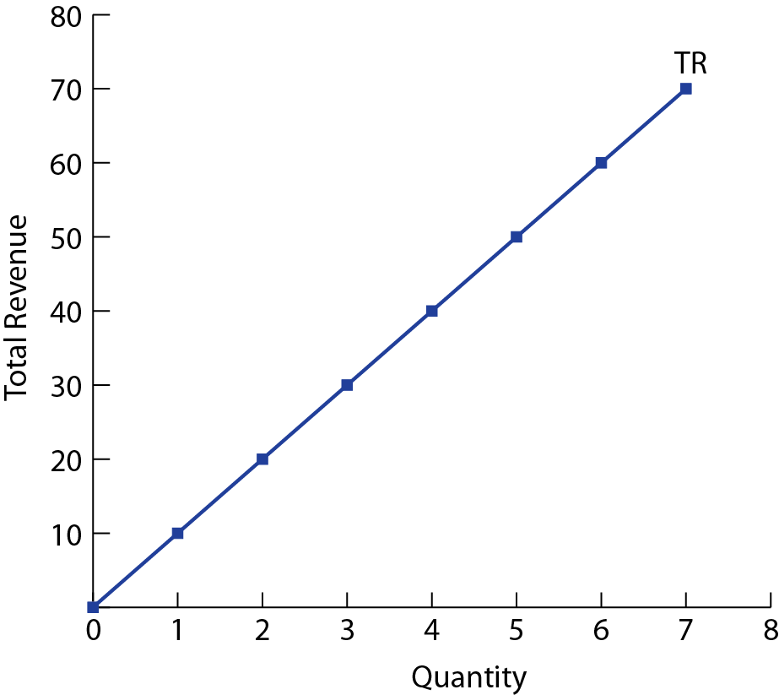
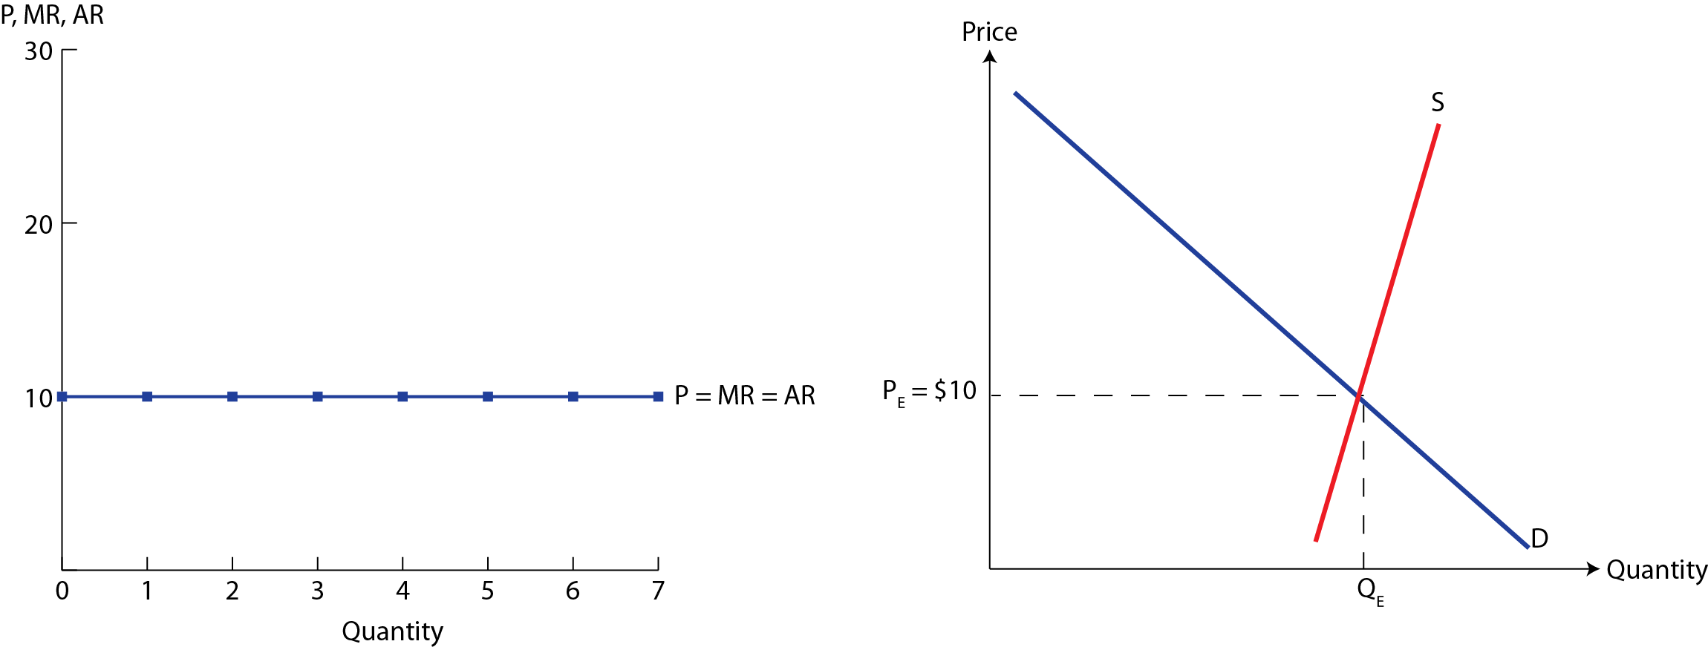
For a perfectly competitive firm, P = D = MR = AR

Slide 79
Revenues for Imperfect Competition
Imperfectly competitive firms have some degree of control over price, and the price varies with output. Such market structures include,
Monopolistic competition, Oligopoly, and Monopoly
Output (Q) | Price (P) | Total Revenue TR = P × Q | Marginal Revenue MR = ∆TR ÷ ∆Q | Average Revenue AR = TR ÷ Q
1 | 12 | 12 | 12 | 12
2 | 11 | 22 | 10 | 11
3 | 10 | 30 | 8 | 10
4 | 9 | 36 | 6 | 9
5 | 8 | 40 | 4 | 8
6 | 7 | 42 | 2 | 7
7 | 6 | 42 | 0 | 6
8 | 5 | 40 | − 2 | 5
9 | 4 | 36 | − 4 | 4
10 | 3 | 30 | − 6 | 3

Slide 80
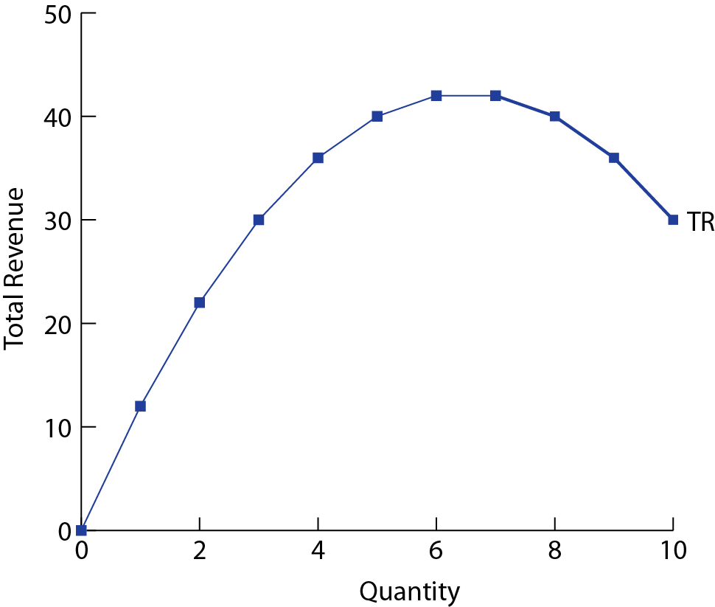
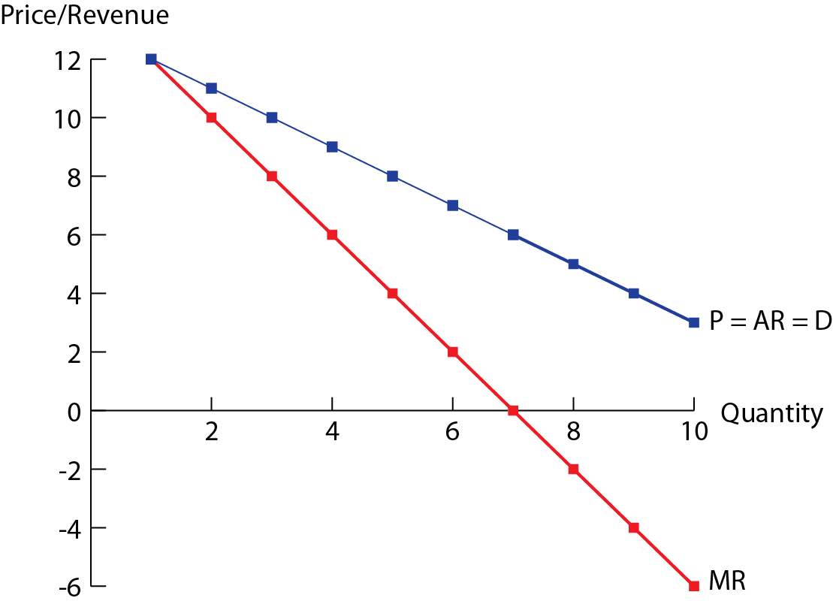

Slide 81
Profit & Revenue Maximization
Recall, Profit = Total revenue − Total cost
= TR − TC
= Total revenue − Explicit costs − Implicit costs
Economic profit can be positive, zero or negative
Supernormal profit: TR > Economic cost (P > AC)
Normal profit: TR = Economic cost (P = AC)
Loss: TR < Economic cost (P < AC)
Profit-maximization rule: a firm in any market structure should produce as close as possible to the point at which marginal revenue equals its marginal costs of production, where MR = MC
Revenue-maximization rule: the revenue for a firm will be maximized at the output level in which MR = 0

Slide 82
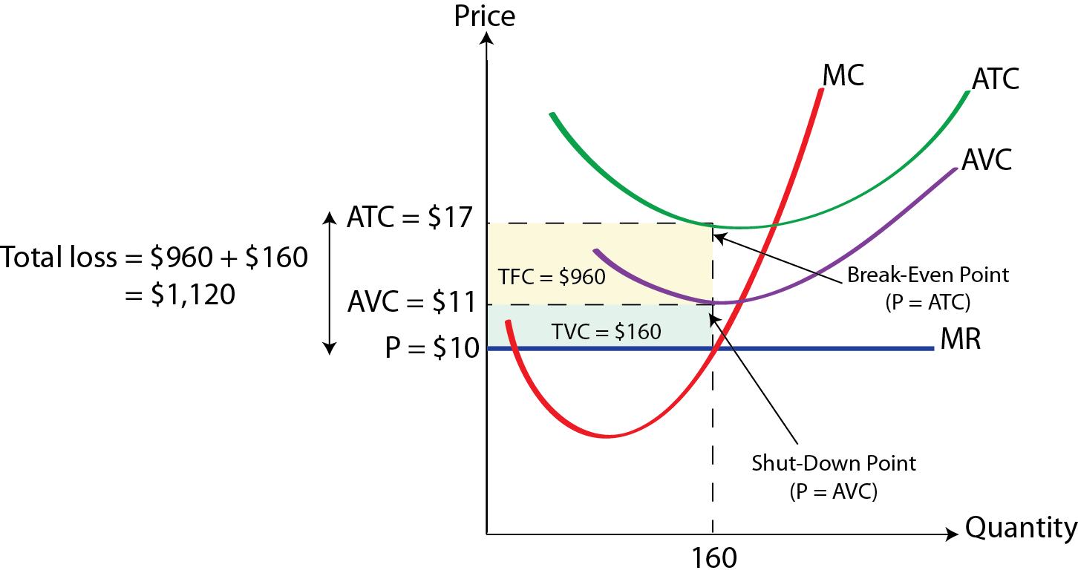
Shut-Down & Break-Even Price
Break-even price: the firm’s break-even price occurs at the level of output for which the firm is earning a normal economic profit (P = AC)
Shut-down price: a firm making an economic loss in the short-run will continue to produce a positive level of output as long as P ≥ AVC

Slide 83
Summary
Concept | Definition | Equation
Revenue Concepts
Total revenue (TR) | The total earnings of a firm from the sale of its output. | TR = P × Q
Marginal revenue (MR) | The additional revenue of a firm arising from the sale of an additional unit | MR = ∆TR ÷ ∆Q
Average revenue (AR) | Revenue per unit of output | AR = TR ÷ Q
Profit Concepts
Economic profit | Total revenue minus economic costs (or total opportunity costs which is the sum of explicit and implicit costs) | Profit = TR − TC
Normal profit | The minimum amount of revenue required by a firm so that it will be induced to keep running. | TR = TC or P = AC

Slide 84
Measures of Economic Activity

Slide 85
Measures of Economic Activity
Recall, there are three ways to measure the value of aggregate output, suggested by the circular flow income model, all giving rise to the same results
1) Expenditure Approach: adds up all spending to buy final goods and services produced within a country over a period.
GDP = C + I + G + (X − M)
2) Income Approach: adds up all income earned by the factors of production that produce all goods and services within a country over a time period.
GDP = W + I + R + P
3) Output Approach: calculates the value of all final goods and services produced in a country over a time period.

Slide 86
Distinction between GDP & GNP
Gross domestic product (GDP): is the market value of all final goods and services produced in a country over a time period, usually a year.
GDP = C + I + G + (X − M)
Gross national product (GNP/GNI): is the value of all final goods and services produced by the factors of production supplied by a country’s residents regardless of where the factors are located.
GNP = GDP + Income from abroad − Income sent abroad
= GDP + Net income from abroad
Green GDP: is an adjustment of traditional GDP, deducting resource and environmental costs in economic activities.
Green GDP = GDP − Value of environmental degradation

Slide 87
Calculating GDP
Example; The table below shows the spending components for the United States national income in 2013.
GDP = C + I + G + (X − M)
= $11.5 + $2.67 + $3.13 + ($2.10 − $2.67)
= $16.73 trillion
Component | Value (in trillions)
Consumption (C) | $11.5
Investment (I) | $2.67
Government Spending (G) | $3.13
Exports (X) | $2.10
Imports (M) | $2.67

Slide 88
Calculating GNP
Example; Suppose in 2013, Canada’s GDP was $1,821 billion; Income earned abroad and sent home to Canada was $110 billion; Income earned in Canada and sent abroad was $29 billion. What was Canada’s 2013 GNP?
GNP = GDP + Net income from abroad
= $1,821 + ($110 − $29)
= $1,902 billion
Since GNP > GDP it indicates that Canada has significant foreign presence, in either workers or companies.

Slide 89
Real GDP & Nominal GDP
Nominal GDP: is measured in terms of current output valued at current prices, which does not account for changes in prices.
Real GDP: is a measure of economic activity that has eliminated the influence of changes in prices.
It measures the value of current output valued at constant prices so a relative comparison can be made to the base year
It is important to use real values when GDP is being compared over time

Slide 90
Example; Real GDP & Nominal GDP
Calculating Nominal GDP
 | 2001 |  |  | 2002 |  |  | 2003
Item | Quantity | Price | Value | Quantity | Price | Value | Quantity | Price | Value
Burgers | 37 | $3 | $111 | 40 | $4 | $160 | 39 | $5 | $195
Haircuts | 15 | $18 | $270 | 17 | $20 | $340 | 18 | $21 | $378
Tractors | 10 | $50 | $500 | 11 | $60 | $660 | 10 | $65 | $650
Nominal GDP |  |  | $881 |  |  | $1160 |  |  | $1223
Calculating Real GDP (Base year- 2001)
 | 2001 |  |  | 2002 |  |  | 2003
Item | Quantity | Price | Value | Quantity | Price | Value | Quantity | Price | Value
Burgers | 37 | $3 | $111 | 40 | $3 | $120 | 39 | $3 | $117
Haircuts | 15 | $18 | $270 | 17 | $18 | $306 | 18 | $18 | $324
Tractors | 10 | $50 | $500 | 11 | $50 | $550 | 10 | $50 | $500
Real GDP |  |  | $881 |  |  | $976 |  |  | $941

Slide 91
GDP Deflator
The GDP deflator is a price index that is an indicator of price changes for all good and services produced in the economy
GDP Deflator = (Nominal GDP ÷ Real GDP) × 100
The index number for the base year is always 100, for all indices
An increasing GDP deflator indicates rising prices on average, while a decreasing GDP deflator indicates falling prices.
Year | Nominal GDP | Real GDP | GDP Deflator
2001 | $881 | $881 | 100
2002 | $1160 | $976 | 118.8
2003 | $1223 | $941 | 130

Slide 92
GDP Deflator & Real GDP
The GDP deflator is a price index that is commonly used to covert nominal GDP to real GDP.
Real GDP = (Nominal GDP ÷ GDP Deflator) × 100
= (Nominal GDP ÷ CPI) × 100
Example; Suppose the nominal GDP was $7,850 billion in 2001; $9,237 billion in 2002; and $10,732 billion in 2003. The GDP deflator was 100 in 2001; 118.8 in 2002; and 130 in 2003.
Real GDP₂₀₀₁ = ($7,850 ÷ 100) × 100
= $7,850 billion
Real GDP₂₀₀₂ = ($9,237÷ 118.8) × 100
= $7,775 billion
Real GDP₂₀₀₃ = ($10,732 ÷ 130) × 100
= $8,255 billion

Slide 93
Calculating Economic Growth
Recall, economic growth refers to an increase in real GDP over time.
It is usually expressed as a percentage change in real GDP over a specified period of time.
%∆GDP= (GDP_{NEW} − GDP_{OLD}) ÷ GDP_{OLD}
It is important to distinguish between a decrease in GDP and a decrease in GDP growth
A decrease in GDP involves a fall in the value of output produced, which gives rise to a negative growth rate
A decrease in GDP growth, involves falling rates of growth, but the rates may be positive

Slide 94
Example; Economic Growth
Example; Given the values for real GDP we can calculate the growth rates between successive years.
Year | Real GDP ($ Billion) | Growth Rate | Description
2010 | 210 | − | −
2011 | 215.5 | 2.6% | Increasing GDP
2012 | 219.5 | 1.9% | Falling GDP growth
2013 | 223.1 | 1.6% | Falling GDP growth
2014 | 217.0 | −2.7% | Negative GDP growth

Slide 95
Keynesian Multiplier
Keynesian Multiplier (k): tells us the amount by which a particular injection of government spending, investment, or export spending will increase the nation’s total GDP
The spending multiplier is a function of the marginal propensity to consume and is determined from the formula,
k = Change in Real GDP ÷ Initial Change in Expenditure
= 1 ÷ (1 − MPC)
= 1 ÷ (MPS + MPT + MPM)
Recall, that MPC + MPS + MPT + MPM = 1 since if national income increases fractions of the funds will be consumed, saved, taxed and spent on imports

Slide 96
The larger the MPC and the smaller the leakages from the spending stream, the greater the value of the multiplier
The change in GDP (∆GDP) resulting from an initial change in expenditures (∆E) is,
∆GDP = k × ∆E
Example; Suppose the economy is in a recession and the government increases expenditures by $8 million. Assuming the MPC = 0.75 we can determine the value of the multiplier and change in real GDP.
Round | ∆GDP ($ million) | ∆Consumption ($ million)
1 | 8 | 0.75 × 8 = 6
2 | 6 | 0.75 × 6 = 4.5
3 | 4.5 | 0.75 × 4.5 = 3.38
4 | 3.38 | 0.75 × 3.38 = 2.5
Total | 32 | 0.75 × 32 = 24

Slide 97
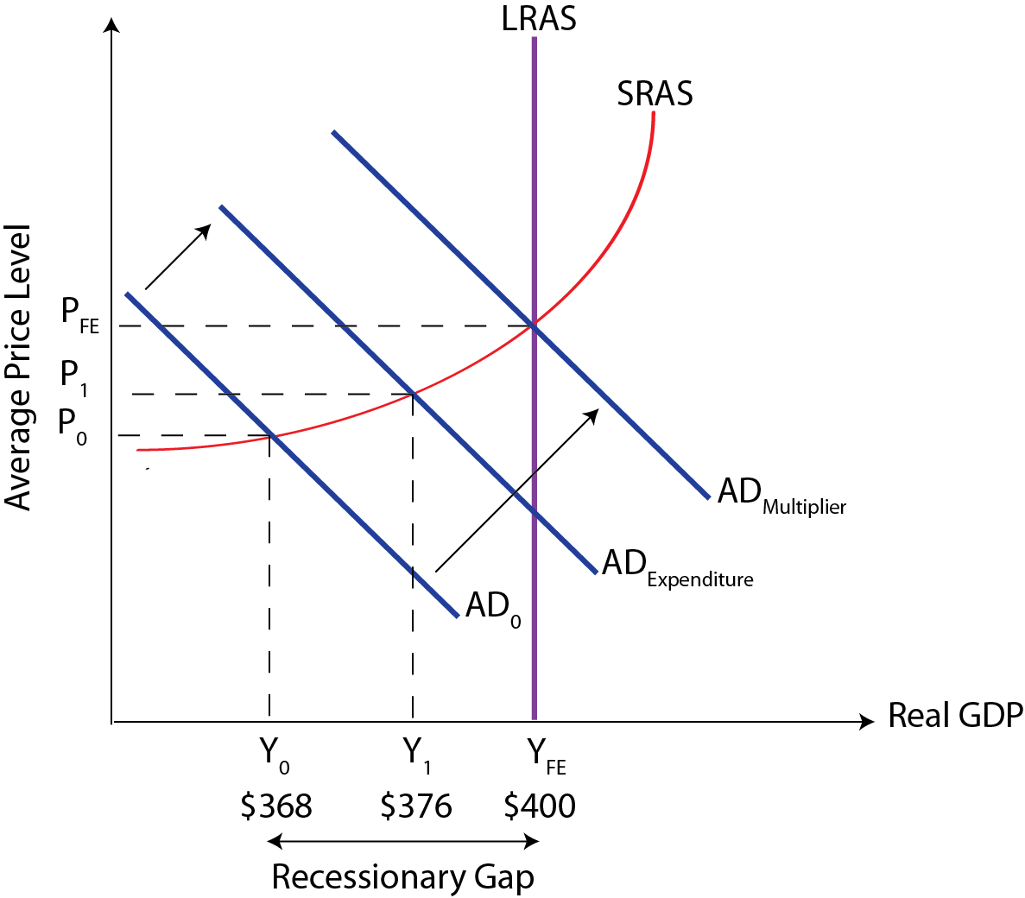
The Keynesian multiplier, k = 1 ÷ (1 − MPC)
= 1 ÷ (1 − 0.75)
= 4
Real GDP increases more than proportionally and the government expenditure of $8 million increases real GDP by $32 million.
∆GDP = k × ∆E
= 4 × $8
= $32 million

Slide 98
Study Questions
1. You are given the following information on an imaginary country called Lakeland.
A. Which year is the base year
B. Calculate real GDP for each of the five years in the table
2. Calculate nominal GDP, given the following information from the national accounts of Flatland (all figures are in billions). Consumer spending $125; Government spending $46; Exports of $12 and imports of $17.
Year | 2006 | 2007 | 2008 | 2009 | 2010
Nominal GDP | 19.9 | 20.7 | 21.9 | 22.6 | 22.3
GDP Deflator | 98.5 | 100 | 102.3 | 107.6 | 103.7

Slide 99
Macroeconomic Objectives

Slide 100
Unemployment
Unemployment: refers to people of working age who are actively seeking employment but are not employed
Unemployment Rate = (Unemployed ÷ Labour Force) × 100
Labour force: is the number of people who are employed plus the number of people of working age that are not employed.
Labour Force = Employed + Unemployed
Labor force participation rate (LFPR): is the ratio of the number of people in the labour force to the entire working age population of a nation
LFPR =[Labor Force ÷ Labor Force Population] × 100

Slide 101
Inflation & Deflation
Inflation: is a sustained increase in the general price level
Disinflation: refers to a decrease in the rate of inflation
Deflation: is a sustained decrease in the general price level
Consumer price index (CPI): is a measure of the cost of living for the typical household and compares the value of a basket of goods and services in one year with the value of the same basket in a base year
Inflation and deflation are measured as a percentage change in the value of the basket from one year to another
%∆CPI = (CPI_{NEW} − CPI_{OLD}) ÷ CPI_{OLD}

Slide 102
Constructing a Weighted Price Index
Weighted price index: is a measure of average price in one period relative to a reference period called a base year.
It is a price index that weighs the various goods and services according to their relative importance in consumer spending.
Price Index_{Current Year} = [Value_{Current Year} ÷ Value_{Base Year}] × 100
To construct a weighted price index,
1) Find the value of the basket in current prices for each year
2) Use the formula to find the price index number for each year

Slide 103
Example; Consumer Price Index
Example; For a simple economy producing only three items we can create the consumer price index and calculate the rate of inflation. Assume that 2012 is the base year.
Price Index₂₀₁₂ = (756 ÷ 756) × 100 = 100
Price Index₂₀₁₃ = (798 ÷ 756) × 100 = 105.5
Price Index₂₀₁₄ = (900 ÷ 756) × 100 = 119
 | 2012 |  |  | 2013 |  | 2014
Item | Quantity | Price | Value | Price | Value | Price | Value
Burgers | 37 | $3 | $111 | $4 | $148 | $5 | $185
DVDs | 25 | $15 | $375 | $14 | $350 | $16 | $400
Haircuts | 15 | $18 | $270 | $20 | $300 | $21 | $315
Total Value |  |  | $756 |  | $798 |  | $900
Year | CPI
2012 | 100
2013 | 105.5
2014 | 119

Slide 104
Example; Calculating Inflation
Example; Given the values for CPI we can calculate the inflation rate between any two years.
Inflation Rate = %∆CPI
= (CPI_{NEW} − CPI_{OLD}) ÷ CPI_{OLD}
Year | CPI | Inflation Rate | Description
2010 | 97.5 | − | −
2011 | 100 | 2.6% | Inflation
2012 | 107.3 | 7.3% | Inflation
2013 | 109.7 | 2.2% | Disinflation
2014 | 107.8 | −1.7% | Deflation

Slide 105
Taxation
Proportional taxation: as income increases, the fraction of income paid as taxes remains constant; there is a constant tax rate.
Progressive taxation: as income increases, the fraction of income paid as taxes increases, there is an increasing tax rate.
Regressive taxation: as income increases, the fraction of income paid as taxes decreases, there is a decreasing tax rate.
Average tax rate (ART): at a particular level of income is found by dividing the amount of tax paid (Tax) by the individual’s gross income (Y)
ART = (Tax ÷ Y) × 100
Marginal rate of taxation (MRT): is the tax rate paid on additional income. It is the change in tax (∆Tax) divided by the change in gross income (∆Y)
MRT = (∆Tax ÷ ∆Y) × 100

Slide 106
Example; Taxation
Example; The following table shows the annual income and marginal income tax rates for Australia. Calculate the annual tax paid, the average tax rate, and the marginal tax rate for an individual earning $59,000
Total tax paid = (0.09 × $15,000) + (0.22 × $30,000) + (0.4 × $4000)
= $9,550
Average tax rate = (Tax ÷ Y) × 100
= ($9,550 ÷ $59,000) × 100
= 16.2%
Annual income ($) | Marginal income tax rate (%)
0 – $10,000 | 0%
$10,001 – $25,000 | 9%
$25,001 – $55,000 | 22%
$55,001 – $115,000 | 40%
$115,001+ | 55%

Slide 107
Study Questions
1. Using the data below construct a price index using 2011 as the base year.
A. Identify the rates of inflation and deflation for consecutive years.
 |  | 2010 | 2011 | 2012 | 2013
Item | Quantity | Price | Price | Price | Price
Pizzas | 35 | $7 | $5 | $7 | $6
DVDs | 9 | $15 | $17 | $18 | $18
Bus rides | 47 | $2 | $4 | $4 | $3

Slide 108
Absolute & Comparative Advantage

Slide 109
Absolute & Comparative Advantage
Absolute advantage: refers to the ability of a country to produce a good using fewer resources than another country
Comparative advantage: arises when a country has a lower relative cost, or opportunity cost, in the production of a good than another country.
Theory of absolute advantage: if countries specialize in and export the good in which they have an absolute advantage, the result is increased production and consumption in each country.
Theory of comparative advantage: as long as opportunity costs in two or more countries differ, it is possible for all countries to gain from specialization and trade according to their comparative advantage.

Slide 110
Law of Absolute Advantage
Example; Consider a simple world economy of two countries Coffenia and Robotica, that produce coffee and robots
Under autarky, assume that each worker in Coffenia and Robotica allocate their time evenly between production of robots and coffee
Suppose that the countries would trade 1 coffee: 1 robot and that 3 units are traded
 | Coffee or Robots (Production) |  | Autarky (Production) |  | Specialization (Production) |  | Specialization (Consumption)
 | Coffee | Robots | Coffee | Robots | Coffee | Robots | Coffee | Robots
Coffenia | 8 | 4 | 4 | 2 | 8 | 0 | 5 | 3
Robotica | 3 | 6 | 1.5 | 3 | 0 | 6 | 3 | 3
Total | − | − | 5.5 | 5 | 8 | 6 | 8 | 6

Slide 111
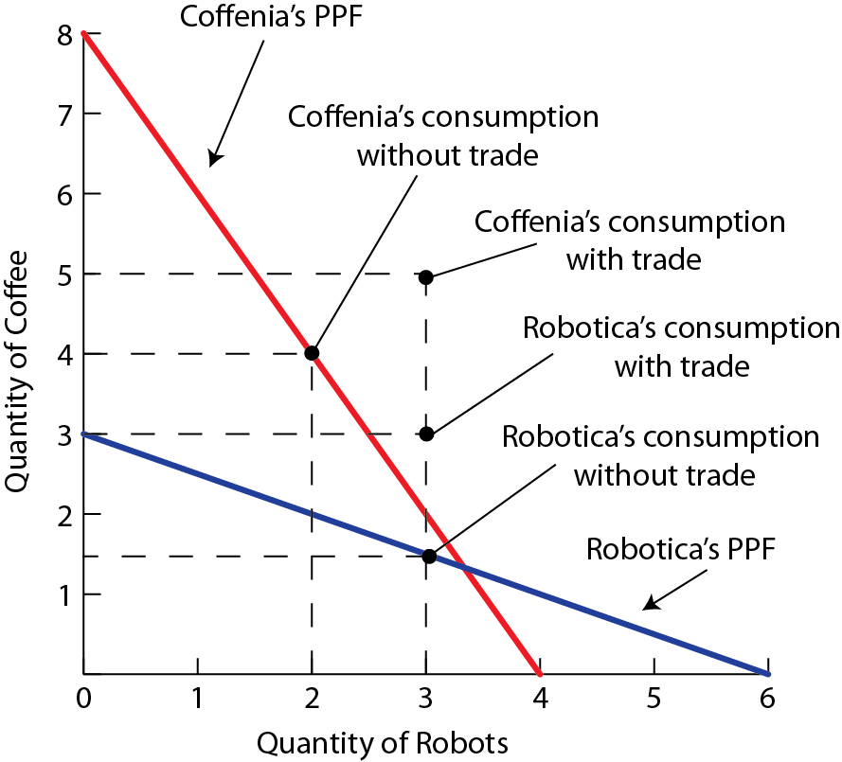
Originally, both countries were producing on their PPF
Trade allows countries to consume at a point outside of their PPF
Specialization increases production by 2.5 units of coffee and 1 robot
Specialization according to absolute advantage leads to a global reallocation of resources where production takes place by the most efficient producers

Slide 112
Law of Comparative Advantage
Example; Consider a simple world economy of two countries Cottonia and Microchippia, producing cotton and microchips.
Suppose that the countries trade 1 cotton: 1 microchip and that 10 units are traded
Since Cottonia has a lower opportunity cost in the production of cotton the country would specialize in cotton production
Cottonia would export cotton and import microchips
 | Cotton or Microchips (Production) |  | Cotton (Opportunity Cost) | Microchips (Opportunity Cost)
 | Cotton | Microchips
Cottonia | 20 | 10 | 10 ÷ 20 = 0.5 | 20 ÷ 10 = 2
Microchippia | 25 | 50 | 50 ÷ 25 = 2 | 25 ÷ 50 = 0.5

Slide 113
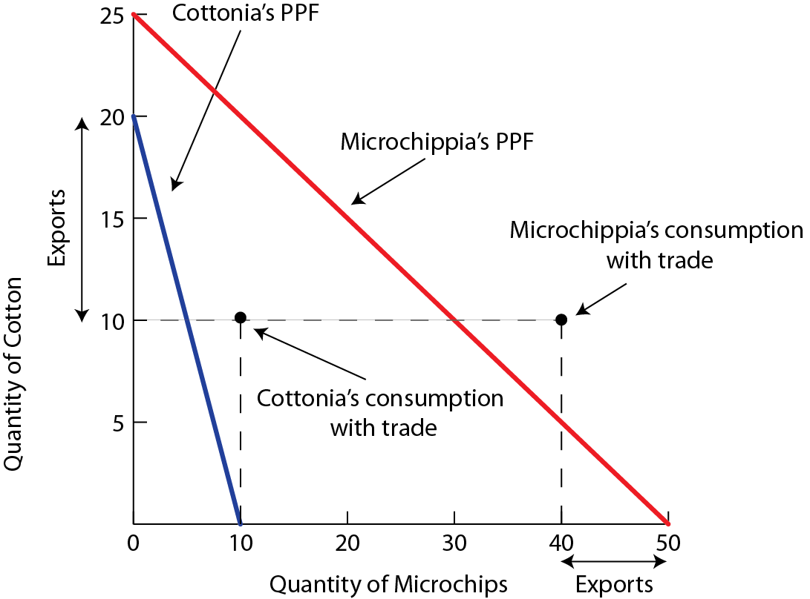
Microchippia has a lower opportunity cost in the production of microchips and would specialize in microchip production
Microchippia would export microchips and import cotton
Trade allows both countries to consume at a point outside of their PPF

Slide 114
Summary
The country that has the flatter PPF has a comparative advantage in the good measured on the horizontal axis
The country that has the steeper PFF has a comparative advantage in the good measured on the vertical axis

Slide 115
Calculating the Effects of Protectionist Policies

Slide 116
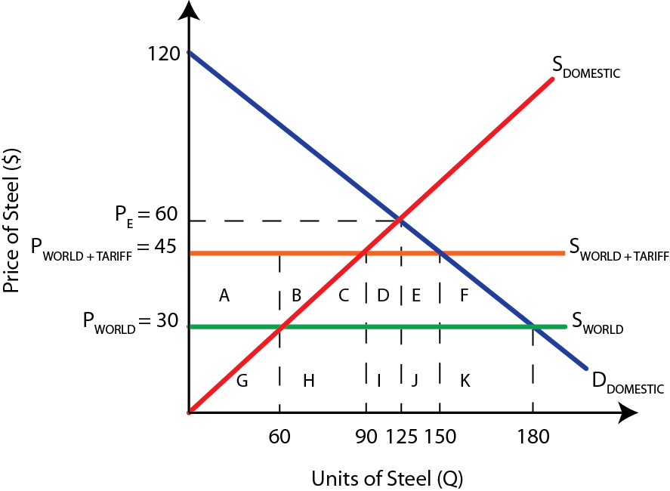
Tariffs
When given specific values for price and quantity, we can calculate the effects of protectionist policies on all relevant stakeholders: domestic and foreign producers, consumers, and the government
Example; The diagram below shows a tariff of $15 per unit placed on steel. Calculate the following before and after the tariff was implemented.
Calculate
1) Domestic revenue
2) Foreign revenue
3) Consumer surplus
4) Government revenue
5) Welfare loss

Slide 117
1) Domestic revenue
Before: P_{WORLD} × Q_{DOMESTIC} = $30 × 60 = $1800
After: P_{TARRIF} × Q_{NEW DOMESTIC} = $45 × 90 = $4050
2) Foreign revenue
Before: P_{WORLD} × Q_{IMPORTS} = $30 × (180 – 60) = $3600
After: P_{WORLD} × Q_{NEW IMPORTS} = $30 × (150 – 90) = $1800
3) Consumer surplus
Before: ½(Highest price – P_{WORLD}) × Q_{WORLD} = 0.5(120 – 30) × 180 = $8100
After: ½(Highest price – P_{TARIFF}) × Q_{TARIFF} = 0.5(120 – 45) × 150 = $5625
4) Government revenue
Before: $0 = No tax collected
After: (P_{TARIFF} × P_{WORLD}) × Q_{NEW IMPORTS} = ($45 – $30 ) × (150 – 90) = $900
5) Welfare loss: (Area C + F)
After: 2(0.5(30 × 15)) = 2 × 225 = $450

Slide 118
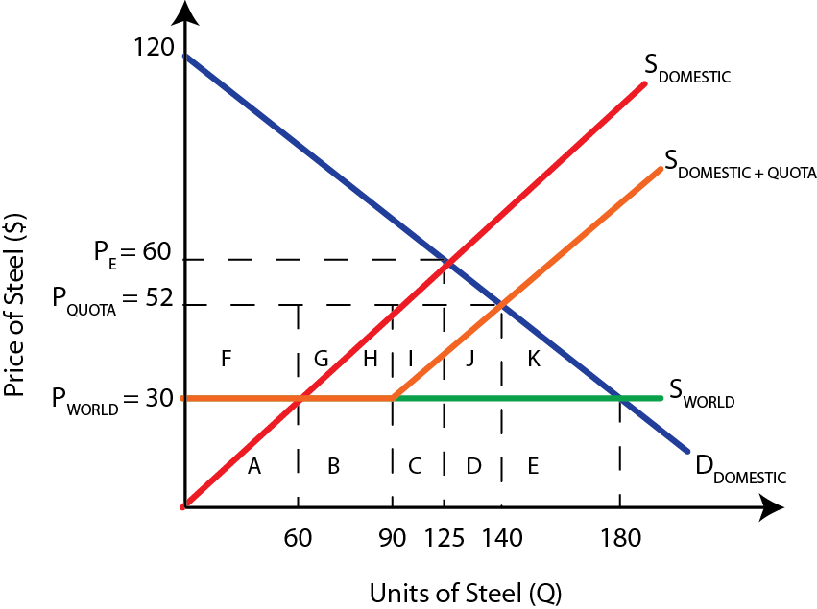
Quotas
Example; The diagram below shows a quota of 30 imported units of steel. Domestic producers previously sold 60 units at the world price of $30. After the quota, they are paid $52 and sell 110.
Calculate the following before and after the quota was implemented.
Calculate
1) Domestic revenue
2) Foreign revenue
3) Consumer surplus
4) Government revenue
5) Welfare loss

Slide 119
1) Domestic revenue
Before: P_{WORLD} × Q_{DOMESTIC} = $30 × 60 = $1800
After: P_{QUOTA} × Q_{NEW DOMESTIC} = $52 × ((60 – 0) + (140 – 90)) = $5720
2) Foreign revenue
Before: P_{WORLD} × Q_{IMPORTS} = $30 × (180 – 60) = $3600
After: P_{WORLD} × Q_{NEW IMPORTS} = $52 × (90 – 60) = $1560
3) Consumer surplus
Before: ½(Highest price – P_{WORLD}) × Q_{WORLD} = 0.5(120 – 30) × 180 = $8100
After: ½(Highest price – P_{QUOTA}) × Q_{QUOTA} = 0.5(120 – 52) × 140 = $4760
4) Government revenue
Before: $0 = No tax collected
After: $0 = No tax collected
5) Welfare loss: (Area J + K)
After: 0.5(50 × 22) + 0.5(40 × 22) = $990

Slide 120
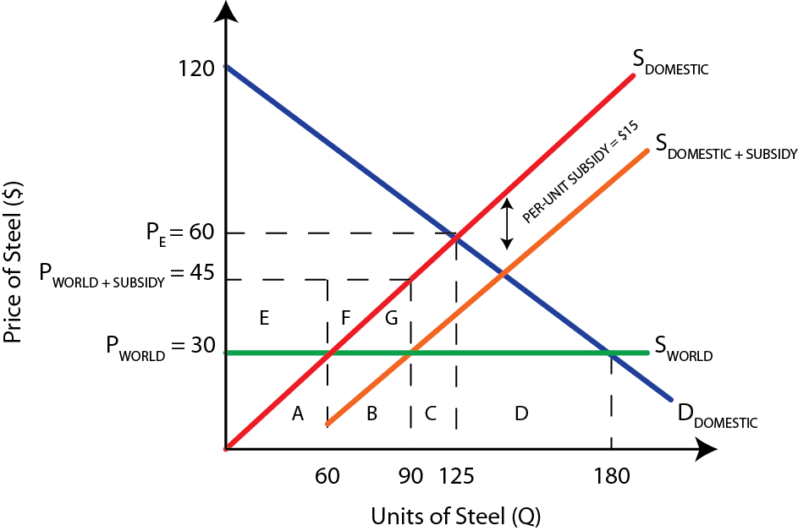
Subsidy
Example; The diagram below shows a per-unit subsidy of $15, the same value as the per unit tariff above. The subsidy is designed to reduce the number of imports
Calculate the following before and after the subsidy was implemented.
Calculate
1) Domestic revenue
2) Foreign revenue
3) Consumer surplus
4) Government revenue
5) Welfare loss

Slide 121
1) Domestic revenue
Before: P_{WORLD} × Q_{DOMESTIC} = $30 × 60 = $1800
After: P_{SUBSIDY} × Q_{NEW DOMESTIC} = $45 × 90 = $4050
2) Foreign revenue
Before: P_{WORLD} × Q_{IMPORTS} = $30 × (180 – 60) = $3600
After: P_{WORLD} × Q_{NEW IMPORTS} = $30 × (180 – 90) = $2700
3) Consumer surplus
Before: ½(Highest price – P_{WORLD}) × Q_{WORLD} = 0.5(120 – 30) × 180 = $8100
After: ½(Highest price – P_{WORLD}) × Q_{WORLD} = 0.5(120 – 30) × 180 = $8100
4) Government revenue
Before: $0 = No subsidy paid
After: Per-unit subsidy × Q_{DOMESTIC} = $15 × 90 = $1350
5) Welfare loss: (Area G)
After: 0.5(15 × 30) = $225

Slide 122
Study Questions
1. Create a free trade diagram that has the following values
A supply curve with quantities 45 units at $15 and 30 units at $10
A demand curve with quantities 15 units at $15 and 30 units at $10
World price of $5 and domestic price of $10
At the world price, domestic quantity of 15
At the world price, foreign imports of 30
1b. Impose a tariff of $3. Draw the expected results for domestic/import quantities on your diagram. Based on your diagram calculate the following
Domestic producer revenue before & after the tariff
Foreign revenue before and after the tariff
Total tariff amount
Areas of inefficiency and welfare loss

Slide 123
Exchange Rate Calculations

Slide 124
Supply and Demand for Currency
Foreign exchange is traded in much the same way as any other product
The supply and demand can be calculated using linear functions
The linear demand equation format is, Q_{D} = a – bP
In this context, P stands for the exchange rate of the currency, in terms of another currency
The linear supply equation format is, Q_{S} = c + dP
When given a supply and demand schedule we can derive these equations and determine the equilibrium

Slide 125
Example; Determining Equilibrium
Suppose the supply function is Q_{S EURO} = 55 + 20P and the demand function is Q_{D EURO} = 100 − 10P
The supply and demand schedules are given in the tables below,
We can determine the equilibrium exchange rate (P) and quantity (Q) by setting supply equal to demand
Exchange Rate Demand Schedule
Exchange Rate (USD per Euro) | Quantity of Euros Demanded (Billions)
2 | 80
1.75 | 82.5
1.5 | 85
1.25 | 87.5
1 | 90
Exchange Rate Supply Schedule
Exchange Rate (USD per Euro) | Quantity of Euros Supplied (Billions)
2 | 95
1.75 | 90
1.5 | 85
1.25 | 80
1 | 75

Slide 126
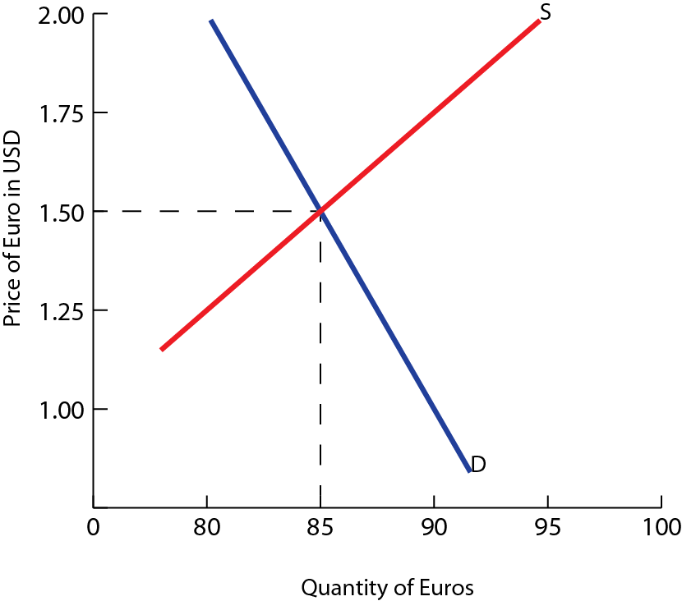
Setting demand equal to supply,
Q_{D EURO} = Q_{S EURO}
100 -10P = 55 + 20P
30P = 45
P = 1.5
So, the equilibrium exchange rate is $1.50 per euro and the equilibrium quantity is 85 billion Euros

Slide 127
Changes in Foreign Exchange Equilibrium
Free floating exchange rates are subject to change, and these changes can be expressed using linear functions
In linear demand functions, a represents the autonomous demand
When this amount changes, demand has changed, and a new curve representing a new set of prices and quantities must be created
The same is true for c in linear supply functions
A change in c is a change in supply, requiring a new supply schedule and curve

Slide 128
Changes in Demand for Currency
Suppose the a variable of demand in the previous example has increased by 7.5 from 100 to 107.5
The new demand function is Q_{D EURO} = 107.5 − 10P
This increases demand at all prices and results in a new demand schedule.
Exchange Rate Market Schedule
Exchange Rate (USD per Euro) | Quantity of Euros Demanded (Billions) | Quantity of Euros Supplied (Billions)
2 | 87.5 | 95
1.75 | 90 | 90
1.5 | 92.5 | 85
1.25 | 95 | 80
1 | 97.5 | 75

Slide 129
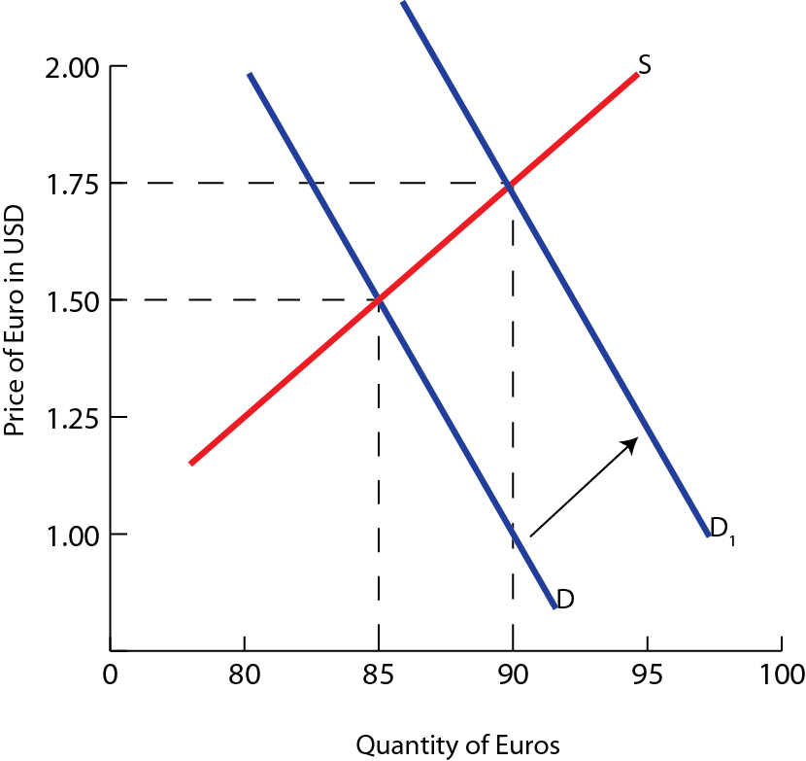
Setting demand equal to supply,
Q_{D EURO} = Q_{S EURO}
107.5 -10P = 55 + 20P
30P = 52.5
P = 1.75
So, the equilibrium exchange rate is $1.75 per euro and 90 billion Euros are bought and sold

Slide 130
Changes in Supply of the Currency
Suppose the c variable of supply in the original example has increased by 15 units from 55 to 70
The new supply function is Q_{S EURO} = 70 + 20P
All supply quantities have increased by 15 units. This represents an increased supply at all prices and a parallel shift of the supply curve
Exchange Rate Market Schedule
Exchange Rate (USD per Euro) | Quantity of Euros Demanded (Billions) | Quantity of Euros Supplied (Billions)
2 | 80 | 110
1.75 | 82.5 | 105
1.5 | 85 | 100
1.25 | 87.5 | 95
1 | 90 | 90

Slide 131
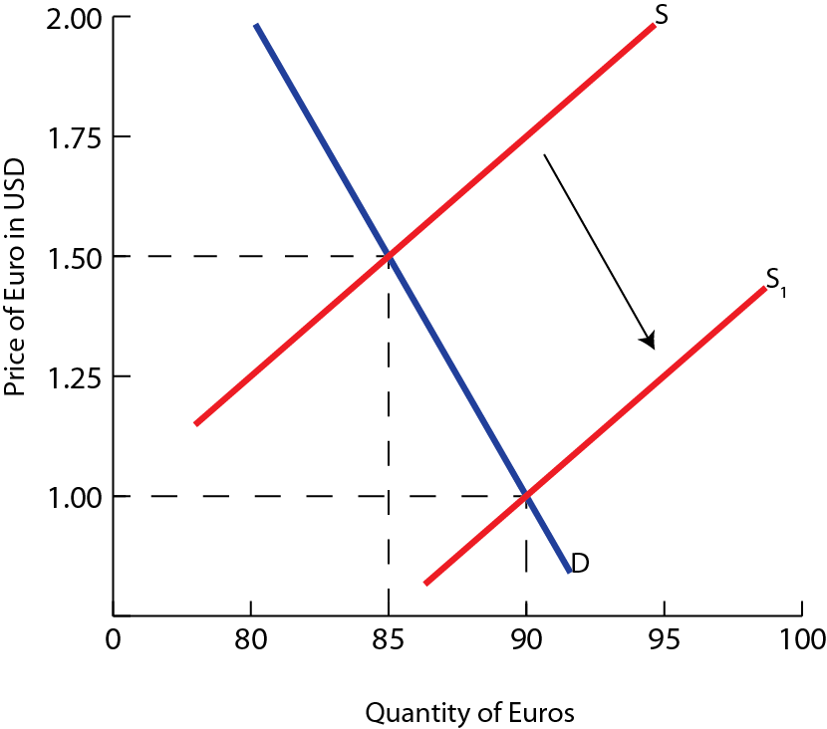
Setting demand equal to supply,
Q_{D EURO} = Q_{S EURO}
100 -10P = 70 + 20P
30P = 30
P = 1
So, the equilibrium exchange rate is $1 per euro and 90 billion Euros are bought and sold

Slide 132
Calculating Exchange Rates from Data
Currency information is reported in many forms and can be deduced from various sources of information
You need to be able to calculate exchange rates from different types of data
Example; Last year, Japan could import athletic jerseys from China costing 60 RMB, which cost 720 JPY at current exchange rates. Now the same 60 RMB jersey costs 780 JPY. What is the current exchange rate?
The exchange rate of RMB last year was 12 JPY (1 RMB: 12 JPY)
The exchange rate of RMB this year is 13 JPY (1 RMB: 13 JPY)
The Japanese Yen has depreciated relative to the Chinese Yuan

Slide 133
Study Questions
1. Given the following linear demand and supply functions for USD in terms of Chinese RMB
Q_{S} = 10 + 3P and Q_{D}= 50 – 2P
Calculate the exchange rate for USD in terms of RMB
Plot the linear supply and demand curves on a diagram indicating the equilibrium price and quantity
2. Assume the exchange rate for British pounds and USD is 1.60 USD per GBP
Calculate the value in GBP for 1 USD
Calculate in USD the price of a Manchester United football jersey that costs 45 GBP

Slide 134
Balance of Payments

Slide 135
Balance of Payments
Balance of payments: of a country is a record (usually for a year) of all transactions between the residents of the country and the residents of all other countries
Current account: consists of the balance of trade in goods and services, net change income and the net change in current transfers
Income: refers to inflows of wages, rent, interest and profits from abroad minus outflows to foreign countries.
∆Income = Inflows − Outflows
Current Account + Financial Account + Capital Account = 0
Current Account = Balance of trade + ∆Income + ∆Current transfers

Slide 136
Current transfers: refers to inflows and outflows of funds for items such as gifts, foreign aid and pensions from government or private citizens
∆Current transfers = Inflows − Outflows
Current Account
(1) Exports of goods | + 40
(2) Imports of goods | − 65
Balance of trade in goods (1) + (2) | − 25
(3) Exports of services | + 25
(4) Imports of services | − 25
Balance of trade in services (3) + (4) | + 10
Balance of trade in goods & services | − 15
(5) Income (inflows minus outflows) | − 6
(6) Current transfers (inflows minus outflows) | + 1
Balance on Current Account | − 20

Slide 137
Capital Account: records the transactions involving ownership of capital, forgiveness of debt, or the acquisition and disposal of intangible assets between a nation and all other nations
Capital Account = ∆Capital Transfers + ∆Intangible Assets
Capital Transfers: when a nation’s government or private sector gives money to another nation for the purchase of fixed assets or directly donates capital goods to the residents of another country
∆Capital Transfers = Inflows − Outflows
Capital Account
(7) Capital transfers (inflows minus outflows) | + 0.7
(8) Intangible Assets (inflows minus outflows) | + 0.3
Balance on Capital Account | + 1

Slide 138
Financial Account: measures the exchanges between a nation and the rest of the world involving ownership of financial and real assets
Financial Account = ∆FDI + ∆Portfolio Investment + ∆Reserves
Reserves: refer to foreign currency reserves that a central bank can buy or sell to influence the value of the country’s currency
Buying domestic currency and selling foreign currency is an inflow
∆Reserves = Inflows − Outflows
Financial Account
(9) Direct investment (inflows minus outflows) | + 23
(10) Portfolio investment (inflows minus outflows) | − 4
(11) Reserve assets | + 1
Balance on Financial Account | + 20

Slide 139
The current account balance is matched by the sum of the capital account balance and the financial account balance.
Current Account + Financial Account + Capital Account = 0
Current Account = − (Capital Account + Financial Account)
Balance of Payments
Balance on Current Account | − 20
Balance on Capital Account | + 1
Balance on Financial Account | + 20
Errors and omissions | − 1
Balance of Payments | 0

Slide 140
Marshall-Lerner Condition
Recall, the Marshall-Lerner condition states the following.
If PED_{M} + PED_{X} > 1 then devaluation or depreciation of the currency will improve the trade balance (smaller trade deficit)
If PED_{M} + PED_{X} = 1 then devaluation or depreciation of the currency will leave the trade balance unchanged
If PED_{M} + PED_{X} < 1 then devaluation or depreciation of the currency will worse the trade balance (larger trade deficit)

Slide 141
Terms of Trade

Slide 142
Terms of Trade
Terms of trade: refers to the ratio of a country’s average price of exports to the country’s average price of imports
The terms of trade are set to 100 in the base year, the reference point for future changes.
An improvement in the terms of trade, represents an increase in the value of average export prices to average import prices. It involves a fall in the opportunity cost of imports
Terms of Trade = (Index of Export Prices ÷ Index of Import Prices) × 100
Condition | Impact on Terms of Trade
Terms of trade < 100 | Deterioration
Term of trade = 100 | Unchanged (Base level)
Terms of trade > 100 | Improved

Slide 143
Example; Terms of Trade
The table below shows the average export and import prices over a period of six years. Calculate the terms of trade for each year
Year | Index of Average export prices | Index of Average import prices | Calculation of terms of trade | Terms of trade | Change
Year 1 | 100 | 100
Year 2 | 100 | 105
Year 3 | 109 | 105
Year 4 | 116 | 112
Year 5 | 120 | 110
Year 6 | 120 | 125
(100÷100)×100 | 100 | Base year
(100÷105)×100 | 95.2 | Deterioration
(109÷105)×100 | 103.8 | Improvement
(116÷112)×100 | 103.5 | Deterioration
(120÷110)×100 | 109.1 | Improvement
(120÷125)×100 | 96 | Deterioration

Slide 144
Example; Terms of Trade
Example; Suppose Morocco exports only tangerines (40% of exports) and carpets (60% of exports) and imports only cars (30% of imports) and industrial equipment (70% of imports).
The prices of these things in Moroccan dirhams in various years are listed below:
If we want to set up 2011 as the ‘base’ year, then we accept that the prices in 2011 are the starting point. Thus, the terms of trade in 2011 are ‘100’
 | 2011 | 2012 | 2013
Tangerines (Dh/kg) | 10 | 13 | 12
Carpets (Dh/m²) | 110 | 110 | 110
Cars (Dh/unit) | 100,000 | 100,000 | 100,000
Industrial Equipment (Dh/unit) | 10,000 | 9,000 | 8,000

Slide 145
First, calculate the index of export prices for 2012 and 2013
Price Index = ∑[Weight × (New Price ÷ Old Price) × 100]
Export Price Index₂₀₁₂ = [0.4 (13 ÷ 10) × 100] + [0.6 (110 ÷ 110) × 100]
= 52 + 60
= 112
Export Price Index₂₀₁₃ = [0.4 (12 ÷ 10) × 100] + [0.6 (110 ÷ 110) × 100]
= 48 + 60
= 108
Next, calculate the index of import prices for 2012 and 2013
Import Price Index₂₀₁₂ = [0.3 (10 ÷ 10) × 100] + [0.7 (9 ÷ 10) × 100]
= 30 + 63
= 93

Slide 146
Import Price Index₂₀₁₃ = [0.3 (10 ÷ 10) × 100] + [0.7 (8 ÷ 10) × 100]
= 30 + 56
= 86
Now, having both the import and export price indexes, we can calculate the terms of trade
This increase shows that Morocco’s terms of trade improved in 2012 and 2013 as export prices (for tangerines) rose in 2012 and import prices (for industrial equipment) fell both years
Year | Index of Export prices | Index of Import prices | Terms of trade
2011 | 100 | 100 | 100
2012 | 112 | 93 | 120.4
2013 | 108 | 86 | 125.6

